Slide 1
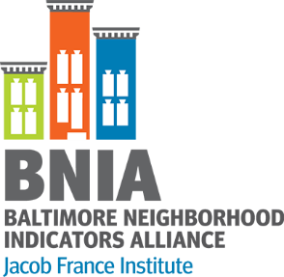
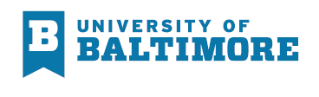
bniajfi.org
BALTIMORE Community Indicators Roundtable
Crime, Safety and Justice
#VitalSigns16

Slide 2

History of BNIA-JFI
bniajfi.org
Strengthening neighborhoods through meaningful, accurate, open data
“Democratization of Data” Overcome the resistance of local public agencies to sharing data
Baltimore one of the first National Neighborhood Indicator Partnership cities
Moved to the Jacob France Institute in 2007

Slide 3
Community Based Indicators
Neighborhood context influences how activities and policies take hold
Bits of information that, when combined, generate a picture of what is happening in a local system
They provide insight into and ongoing monitoring of the overall direction of a community
Rhonda Phillips, Community Indicators 2003
Economic
Social
Environmental
Cultural

Slide 4
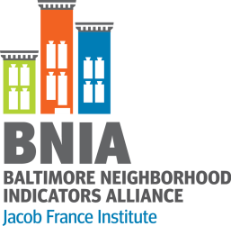
Choosing Indicators: Guiding Principles
bniajfi.org
Reliable
Available (Now or Future)
Explanatory Power (Parsimony)
Actionable
Data is accessible and from a valid, reliable source
Baseline measures can be tracked over time
Key indicator “gets to the heart” of a broader concept
Indicator is actionable (i.e. communities can work to change the trajectory of a measure)
Coordinating indicators with existing/parallel processes envisioning Baltimore’s future

Slide 5
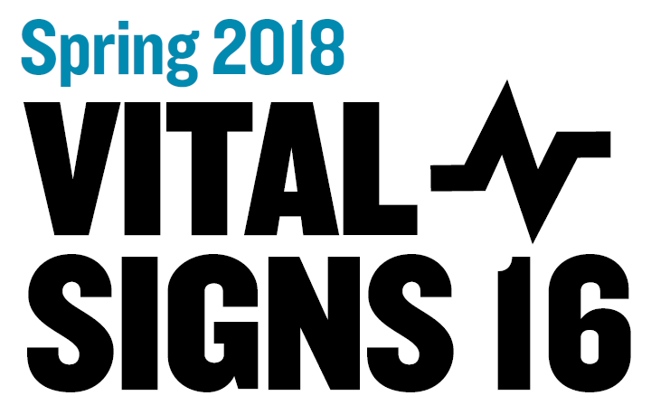
postgreSQL
postGIS Geodatabase
CitiStat
Library
Schools
Vital Statistics
Police
Arts
bniajfi.org
5

Slide 6
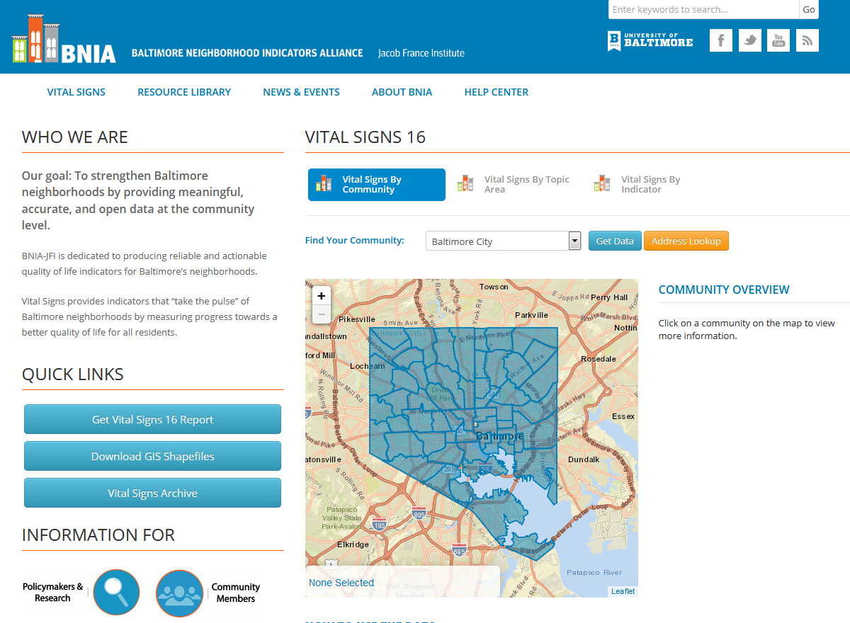
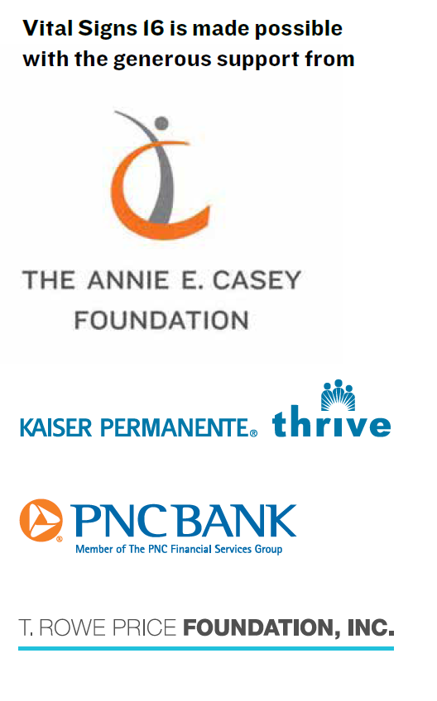
bniajfi.org
bniajfi.org/vital_signs

Slide 7
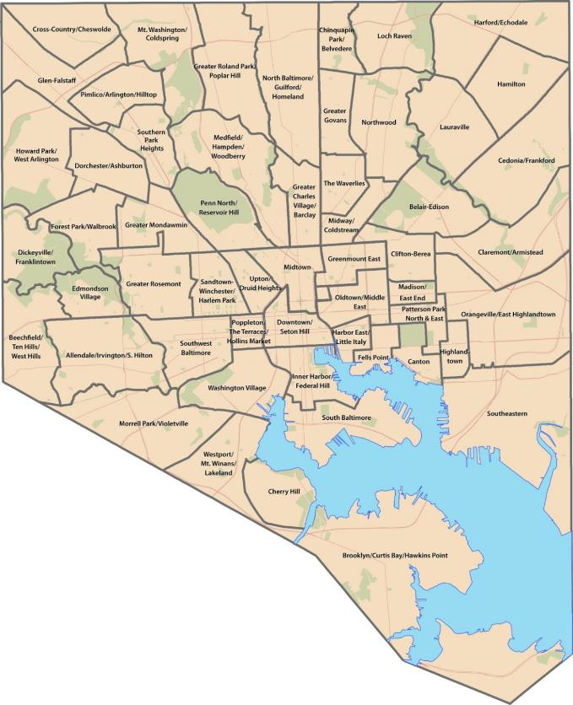
Community Statistical Areas (CSAs)
bniajfi.org
Based on U.S. Census geographic areas (Census Tracts)
  200 Tracts merged together to form 55 Communities
Allows for easier visualization of patterns and trends across the city

Slide 8
Vital Signs Chapters
bniajfi.org
Census Demographics
Housing & Community Development
Children and Family Health
Crime & Safety
Workforce & Economic Development
Sustainability
Education & Youth
Arts & Culture

Slide 9
Current Crime Indicators
bniajfi.org
Part 1 Crime Rate
  Violent Crime Rate
  Property Crime Rate
  Rate of Gun Related Homicides
Rate of Adult Arrests
Rate of 911 Calls for Service
  Shootings
  Common Assaults
  Narcotics
  Auto Accidents
Rate of 311 Calls for Street Light Outages

Slide 10
Discontinued Crime Indicators
bniajfi.org
Juvenile Arrest Rate
  Drug-Related Offenses
  Violent Offenses
Rate of 911 Calls for Domestic Violence
Data confidentiality

Slide 11
Development of Crime & Chapter
bniajfi.org
Measuring progress towards safer communities for people to live, work, and play in
What actions can lead to crime reduction? Drawing upon BCJI working in McElderry Park
UN Sustainable Development Goal #16: Peace, Justice, and Strong Institutions
  “Promote peaceful and inclusive societies for sustainable development, provide access to justice for all and build effective, accountable, and inclusive institutions at all levels”

Slide 12
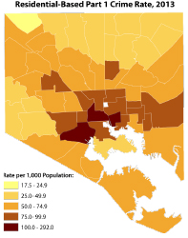
Gaps and Opportunities in Data
bniajfi.org
Prosecution Rates
Initial vs. Final Disposition of Calls and Incidents
Crime Types by Neighborhood
Daytime Crime Rates

Slide 13
bniajfi.org
Break Out Groups
What indicators resonate with you?
What would you like to see added?
What are potential new data sources/
contacts?

