Slide 1
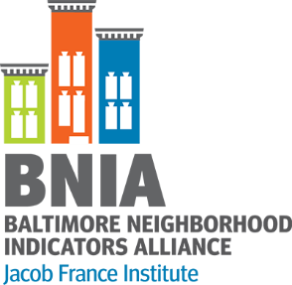
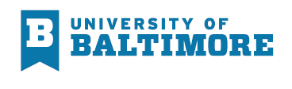
BALTIMORE Community Indicators Roundtable
Sustainability
#VitalSigns16

Slide 2

History of BNIA-JFI
Advanced information systems with integrated and recurrently updated information on neighborhood conditions in their cities
“Democratization of Data” Overcome the resistance
of local public agencies to sharing data
Baltimore one of the first cities
  Now 36 partners
Moved to the Jacob France Institute
in 2007

Slide 3
Community Based Indicators
Neighborhood context influences how activities and policies take hold
Bits of information that, when combined, generate a picture of what is happening in a local system
They provide insight into and ongoing monitoring of the overall direction of a community
Rhonda Phillips, Community Indicators 2003
Economic
Social
Environmental
Cultural

Slide 4
Choosing Indicators: Guiding Principles
Reliable
Available (Now or Future)
Explanatory Power (Parsimony)
Actionable
Data is accessible and from a valid, reliable source
Baseline measures can be tracked over time
Key indicator “gets to the heart” of a broader concept
Indicator is actionable (i.e. communities can work to change the trajectory of a measure)
Coordinating indicators with existing/parallel processes envisioning Baltimore’s future

Slide 5


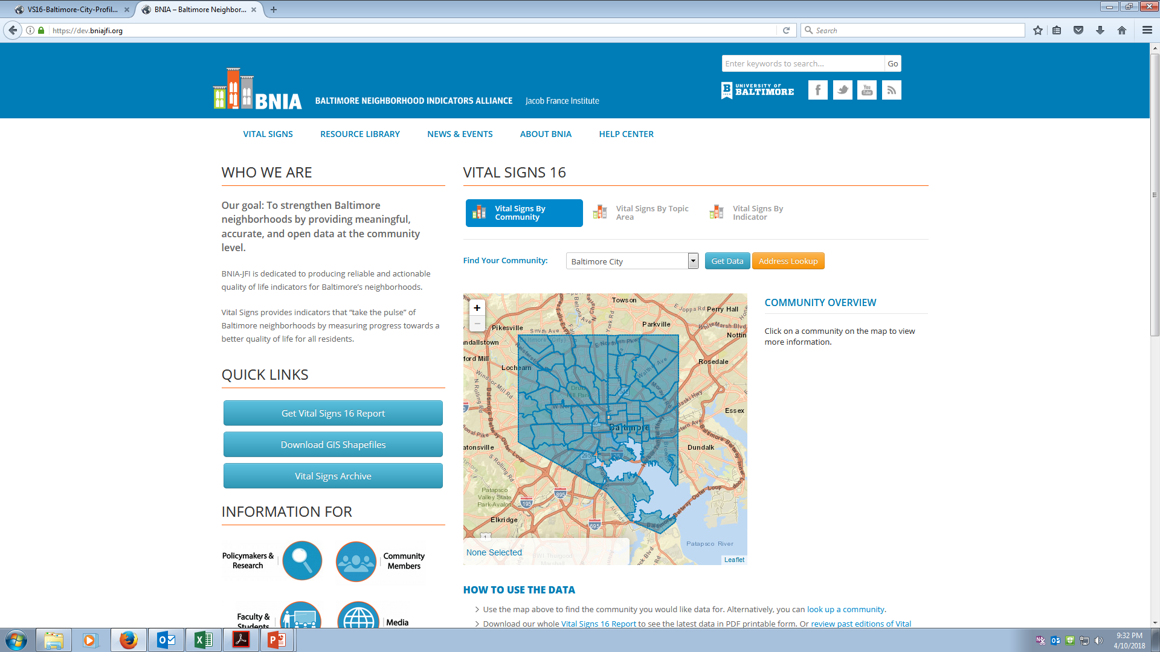
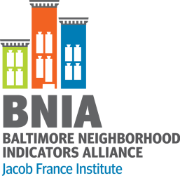
postgreSQL
postGIS Geodatabase
CitiStat
Library
Schools
Vital Statistics
Police
Arts
5

Slide 6
Acquiring Data
Community Requests
Assessment of Potential Data Sources
Identifying Key Agency to Establish Data Sharing
Making Administrative Data Interoperable
Preparing Indicators
Reliable
Routinely- updated
Key Staff
Privacy
Technical
Spatial

Slide 7
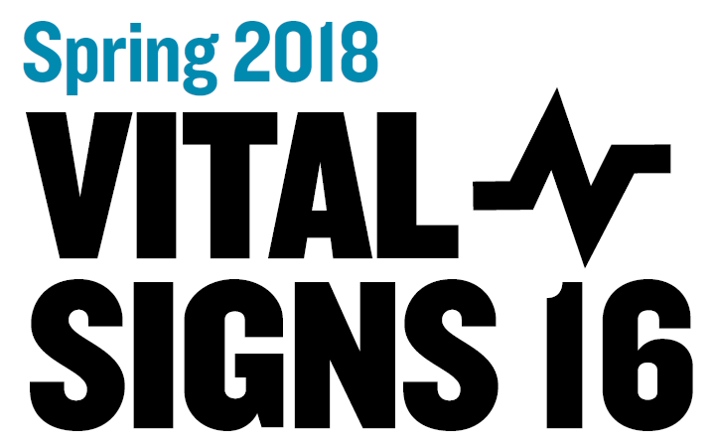
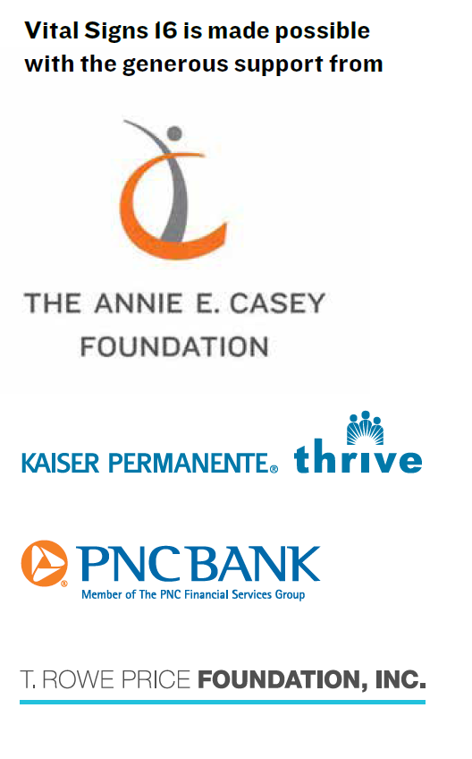

Slide 8
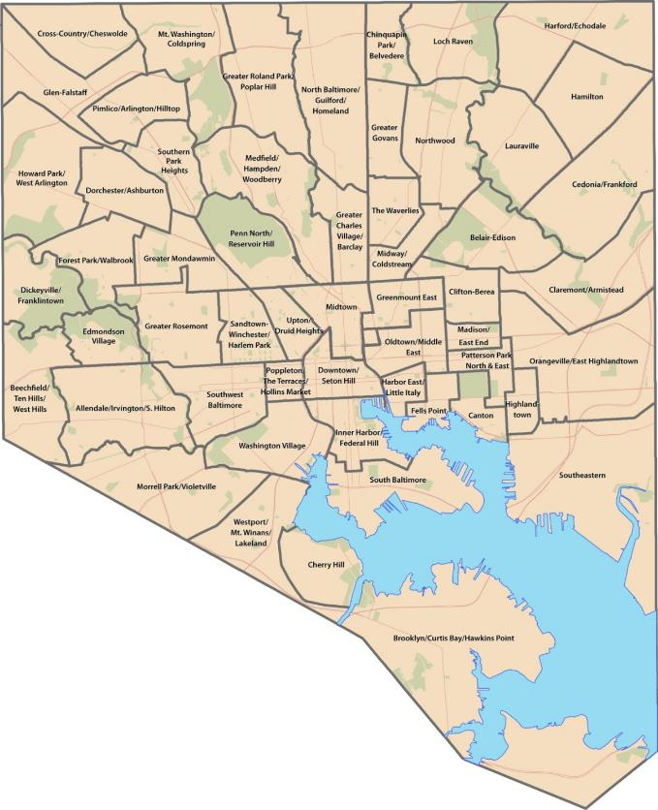
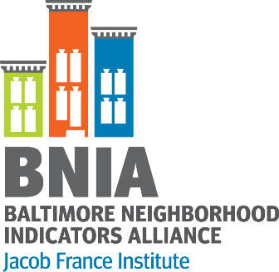
Community Statistical Areas (CSAs)
Based on U.S. Census geographic areas (Census Tracts)
  200 Tracts merged together to form 55 Communities
Allows for easier visualization of patterns and trends across the city

Slide 9
Vital Signs, 2000-2010
Chapters
US Census & American Community Survey
Housing & Community Development
Children and Family Health & Wellbeing
Crime and Safety
Workforce & Economic Development
Sanitation
Urban Environment & Transit
Education & Youth
Neighborhood Action & Sense of Community

Slide 10
Vital Signs, 2011-2016
Chapters
Demographics/US Census
Housing & Community Development
Children and Family Health
Crime and Safety
Workforce & Economic Development
Sustainability
Education & Youth
Arts & Culture

Slide 11
Development of Vital Signs Sustainability Chapter
2009 – Baltimore City adopted the Baltimore Sustainability Plan (29 goals across 7 topics)
  Cleanliness, Pollution Prevention, Resource Conservation, Greening, Transportation, Education Awareness, Green Economy
  Vital Signs Indicators included into the Annual Sustainability Report
2011 – HUD Sustainable Communities Regional Planning Grant
  6 federal principals of livability
  Baltimore added 7th – protection of waters in the Chesapeake Bay
Movement by residents/communities to sustainable behaviors
  Increase in public transit, tree plantings, use of public and private space, and reducing energy use

Slide 12
Sustainability
Percent of Population that Drove Alone to Work
Percent of Population that Carpool to Work
Percent of Population that Uses Public Transportation to Get to Work
Percent of Population that Walks to Work
Percent of Employed Population with Travel Time to Work of 0-14 Minutes
Percent of Employed Population with Travel Time to Work of 0-14 Minutes
Percent of Employed Population with Travel Time to Work of 15-29 Minutes
Percent of Employed Population with Travel Time to Work of 30-44 Minutes
Percent of Employed Population with Travel Time to Work of 45 Minutes and Over
Rate of Dirty Streets and Alleys Reports per 1,000 Residents
Rate of Clogged Storm Drain Reports per 1,000 Residents
Percent of Area Covered by Trees
Number of Community Managed Open Spaces
Median Daily Water Consumption
Percent of Residences Heated by Utility Gas
Percent of Residences Heated by Electricity
Percent of Households with No Vehicles Available
Percent of Homes Weatherized
Percent of Population (Over the age of 18) Who are Registered to Vote
Percent Population (Over the age of 18) Who Voted in the General Election

Slide 13
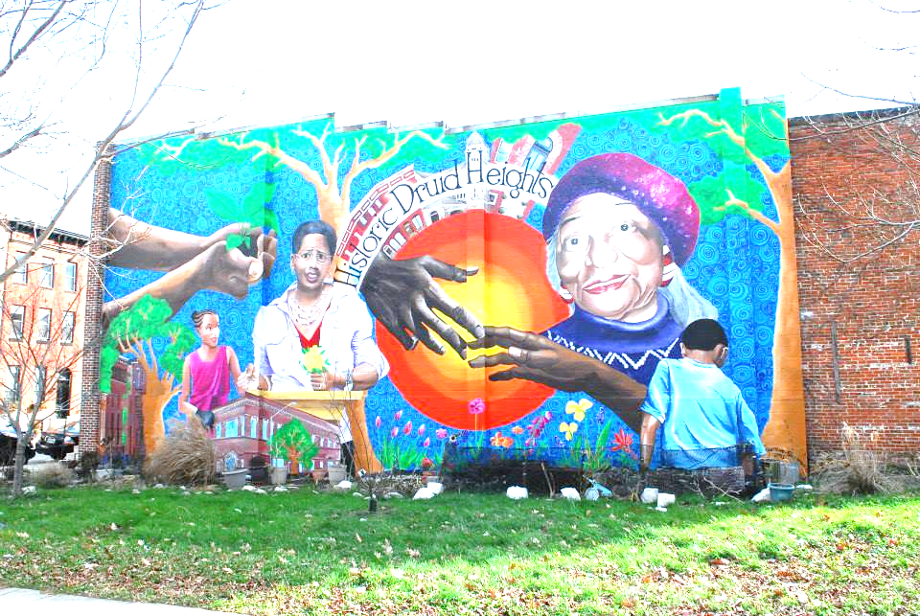
Vitality in Neighborhoods = Umami?
What did we know?
  Baltimore is the cultural and historic center of the region
  Arts and Entertainment Districts:
    Station North (est. 2002), Highlandtown (est. 2003) and Bromo Tower (est. 2012)
Research on Measuring Vitality
  Arts opportunities providing spaces and events for social interaction of increasingly diverse residents (Ann Markusen)
  Talent, Tolerance, Technology -- Creative Class (Richard Florida)
  Presence, Participation, Support -- Urban Institute’s Arts and Culture Indicators Project

Slide 14
Arts & Culture
Number of Persons with Library Cards per 1,000
Number of Event Permits Requested per 1,000 Residents
Public Art per 1,000 Residents
Number of Businesses that are Arts-Related per 1,000 Residents
Total Employment in Arts-Related Businesses
Rate of Businesses in the Creative Economy per 1,000 Residents
Number of Employees in the Creative Economy
Number of Public Murals

Slide 15
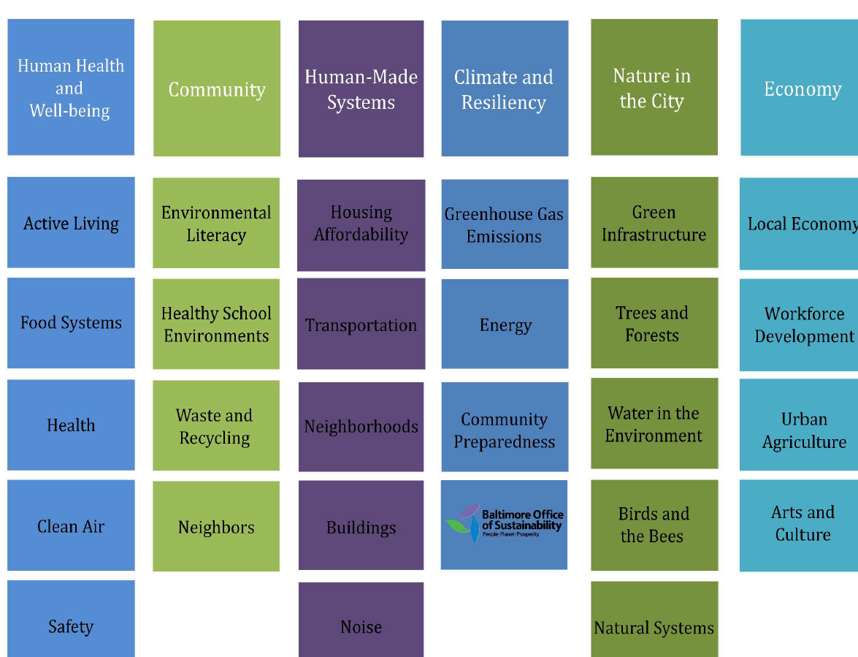
Intro to New Sustainability Plan

Slide 16
Connecting to Sustainability Plan
Energy Use and Education
Climate Change
Urban Agriculture
Natural Systems
Recycling and Reuse
Water Quality
Neighbors
What Data Sources Exist to Measure these at the Neighborhood Level?
What Indicators are Actionable at the Neighborhood Level?

Slide 17

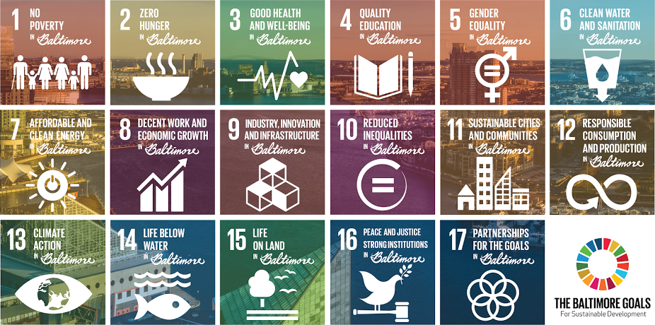
In 2015 UN member states adopted 17 sustainable development goals

Slide 18
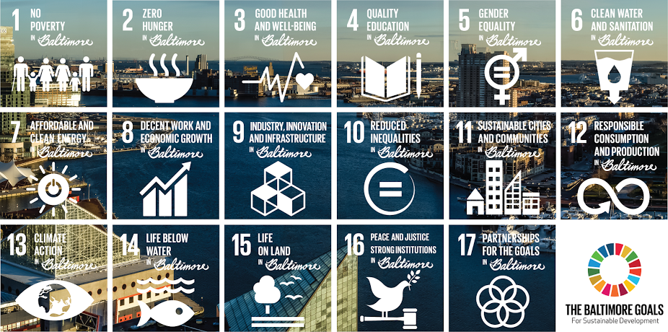
SDGs: A global aspiration the world commits to achieving by 2030

Slide 19
Connecting to Sustainable Development Goals
Justice
Criminalization of Poverty
Living Wage
Sustainable Production
What Data Sources Exist to Measure these at the Neighborhood Level?
What Indicators are Actionable at the Neighborhood Level?

Slide 20
THANK YOU
Questions? Comments?

