Slide 1
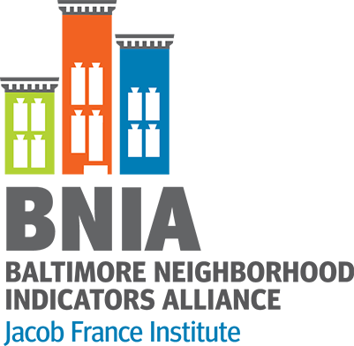
Putting Baltimore’s Opportunity Zones in Context
The Baltimore Neighborhood Indicators Alliance – Jacob France Institute
Seema D. Iyer, PhD
February 25, 2019
www.bniajfi.org

Slide 2
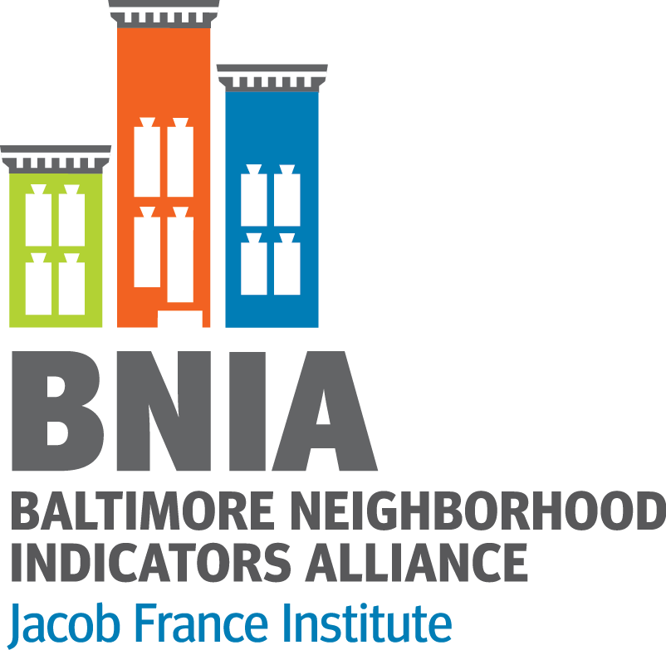
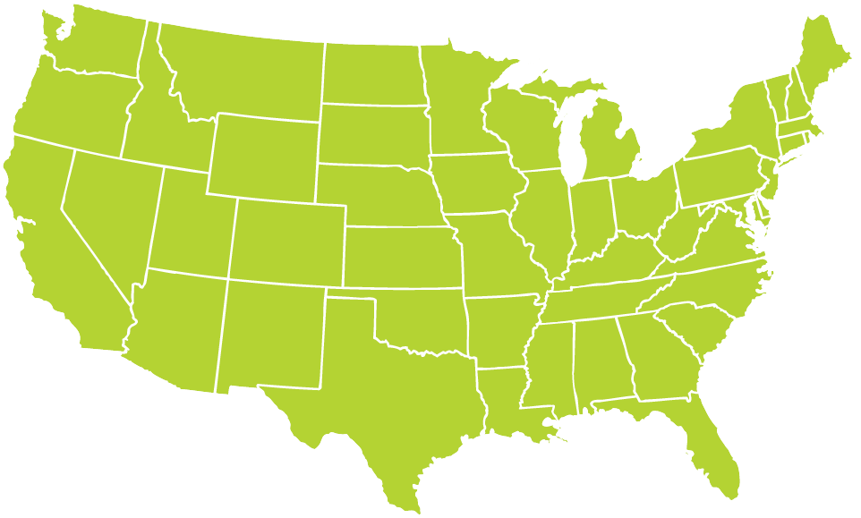
About BNIA-JFI
@bniajfi
Began in 2000 by local stakeholders, now based within Jacob France Institute at University of Baltimore
Prepare the annual “Vital Signs” report and open-data portal of quality of life indicators for Baltimore’s neighborhoods
“One-stop-shop” for comprehensive, non-partisan data indicators and training
Multiple topic areas
Longitudinal data (2000 – 2016)
Member of the National Neighborhood Indicators Partnership hosted at the Urban Institute
30+ cities focusing on data democratization
http://www.neighborhoodindicators.org

Slide 3
Data Sources on the Map
Opportunity Zones (OZ): were enacted into federal law through the Tax Cuts and Jobs Act of 2017 to spur private investment in distressed communities across the United States. Learn more at http://baltimoredevelopment.com/opportunity-zones
Neighborhood Impact Investment Funds (NIIF): created in 2018 by Mayor Pugh to be overseen by a new public-private nonprofit partnership designed to spark investment in and spread economic opportunity to neighborhoods https://mayor.baltimorecity.gov/news/press-releases/2018-12-19-board-estimates-approves-517-million-loan-neighborhood-impact
Community Development Corporations (CDC): To see the full list of community organizations, visit the City’s Community Association Directory (CAD) http://cityservices.baltimorecity.gov/cad/Home.aspx
Community Profiles from the Vital Signs report: Every year the Baltimore Neighborhood Indicators Alliance releases more than 100 quality of life indicators for all communities in Baltimore www.bniajfi.org

Slide 4
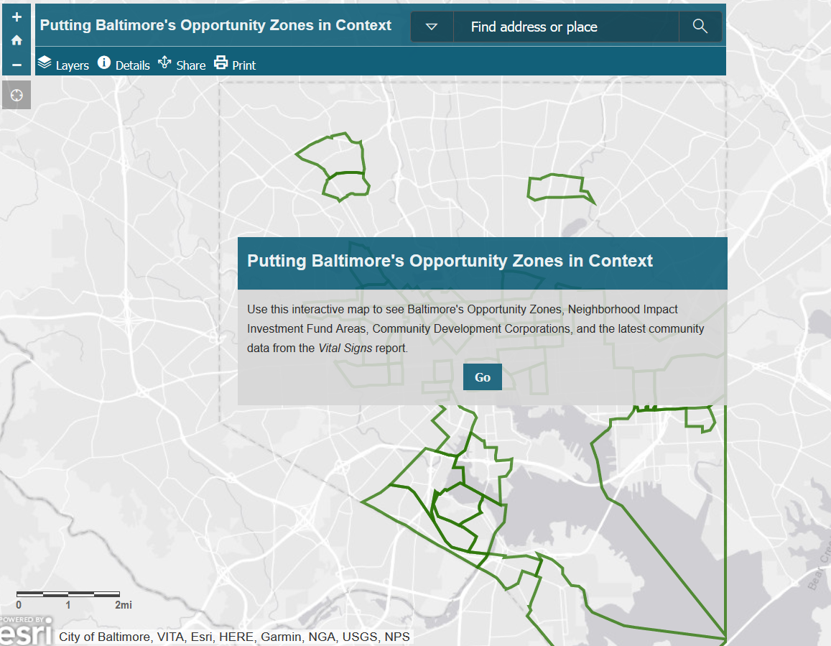
Launch the App (https://arcg.is/00aav0)
@bniajfi

Slide 5
Locations of Baltimore’s OZs
@bniajfi

Slide 6
Vital Signs and OZs
@bniajfi

Slide 7
Vital Signs and OZs
@bniajfi

Slide 8
Vital Signs and OZs
@bniajfi

Slide 9
Finding Community Development Corps
@bniajfi

Slide 10
OZs and NIIF Neighborhoods
@bniajfi

Slide 11
Questions?
@bniajfi
www.bniajfi.org

