Slide 1
Overcoming Barriers to Homeownership in Baltimore City BNIA Data Week Presentation July 2020
By Sally J. Scott, Community Leadership Programs,
University of Maryland Baltimore County
&
Seema Iyer, Jacob France Institute, University of Baltimore

Slide 2
Persistent Racial Inequalities
Report written in 2019, before the COVID-19 pandemic hit.
Prior to the pandemic, clear evidence that we need to address racial income, wealth and homeownership gaps.
Intense urgency now – Black families face greater risk of contracting COVID while suffering housing insecurity.

Slide 3
Initial Focus of Report
Question posed by the Abell Foundation – would expanding flexibly underwritten home loans, and offering more extensive first-time homebuyer incentives, create more homeowners in Baltimore?
Time frame we explored: 2010 (captures impact of Great Recession) to 2017 -- last year full data sets were available when we were writing this paper in summer and fall 2019.

Slide 4
Data Used
Quantitative
Focus on neighborhood level, connections to income and race
Homeownership and mortgage statistics, using American Community Survey, Maryland Property View, and Home Mortgage Disclosure Act (HMDA) data
Qualitative
Review of national and local documents on homeownership, especially analyses of structural racism and decline in Black homeownership
Interviews with leaders of nonprofit organizations -- especially housing counseling, affordable homeownership developers -- lenders and realtors.
Many thanks to all the people who gave of their time and expertise, including Baltimore Equitable CDN’s Advocacy and Policy Committee members.

Slide 5
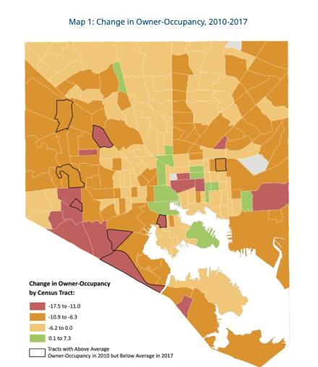
Trends in Owner-Occupancy 2010 to 2017 -- Southwestern edge hit hardest -- Areas with highest rates of loss mostly not in city core -- Throughout City, loss of Black homeowners -- Increases in homeownership occurred where Black populations falling, except where there are long-term revitalization initiatives
Notes:
OVERALL TRENDS: Baltimore homeownership rate fell from 51% to 47%, while Black homeownership rate fell from 45% to 42%.
Both a LOCAL and a NATIONAL CRISIS – there is a 30-percentage point gap between white and Black homeownership rates. (73% to 43%).
ONTRIBUTRING FACTORS -- decades of segregation, redlining, blockbusting, legal and illegal discrimination – and then the GREAT RECESSION hit, which stripped billons of housing value from Black as well as Hispanic communities.

Slide 6
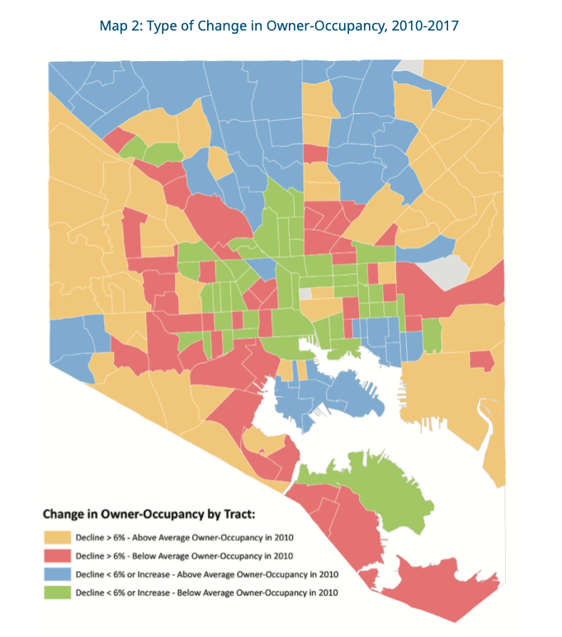
Second View of Owner-Occupancy 2010-2017 -- In West, Southwest, East, and Northeast: areas of solid, primarily Black homeownership impacted -- Also loss of homeowners in areas with higher percentage of rental units -- Lower rates of decline along waterfront, in City core, and in North and Northwest Baltimore

Slide 7
Baltimore’s System of Homeownership Promotion
To help people buy existing homes: extensive array of services and incentives involving homebuyer education, homeownership counseling, nonprofit organizations, Live Baltimore, Baltimore City, State of Maryland, Federal government, local employers, foundations.
Nonprofit affordable housing developers also do complete rehabs of existing homes, construct new affordable homes, reach out to qualified buyers, and provide education and counseling for renters who want to become homeowners.

Slide 8
Results of Existing System
Success in helping homebuyers, especially those who can navigate complex system (some with help) and are financially close to ready.
DHCD’s Office of Homeownership, working closely with Live Baltimore, provided $3.3 million in incentives in FY 2019.
From all sources, multiple loan products, down-payment options, tax credits, renovation programs – complexity without scale.
Affordable housing developers providing sustainable homeownership to around 100 people a year. Valuable for those who move into those homes, but not on a scale to impact City’s homeownership rates.

Slide 9
Barriers to Homeownership
Two Pools of Aspiring Homebuyers:
Smaller pool – ready to buy, with education & incentives
Larger pool -- lack of income, poor credit, high debt
Citywide, from 2010 to 2017, a 30% increase in the median price of homes in Baltimore outstripped a 21% increase in median income.
Fundamental challenge – decades of structural racism, compounded by the Great Recession, have contributed to deep-rooted income, wealth and homeownership gaps for Black Baltimoreans.

Slide 10
How do we change the map?
Business as usual won’t work.
Clear need for new policies at City, State and Federal levels

Slide 11
Recommendations
Maintain a Focus on Racial Equity
Reach out to Current and Potential Residents
Keep effective housing education and counseling, make it easier to navigate loans & incentives.
Support innovative models of financial coaching and outreach to prepare people to buy.
Work with current homeowners, especially elderly, to preserve existing affordable homeownership.
Change Frameworks & Systems
Create a multi-sector, citywide affordable housing policy -- address the high number of vacant and abandoned properties.
Connect homeownership and community development – need affordable homes in inclusive neighborhoods where people want to live.
Support Federal Policies that address shortages of both rental and homeownership housing. Especially important in the COVID-19 era.

Slide 12
Thank you!
Contact information:
Sally J. Scott, sjscott@umbc.edu
Seema Iyer, siyer@ubalt.edu

