Slide 1
THE MARYLAND FOOD SYSTEM MAP
CAITLIN MISIASZEK
JOHNS HOPKINS CENTER FOR A LIVABLE FUTURE
July 22, 2020

Slide 2
WHY MAPPING?
1
  VISUALIZE…
  data across space
  LAYER…
  complex data to understand connections, inequalities and trends among systems
  INFORM…
  and create effective policies and programs
  MONITOR…
  and evaluate change
2
3
4

Slide 3
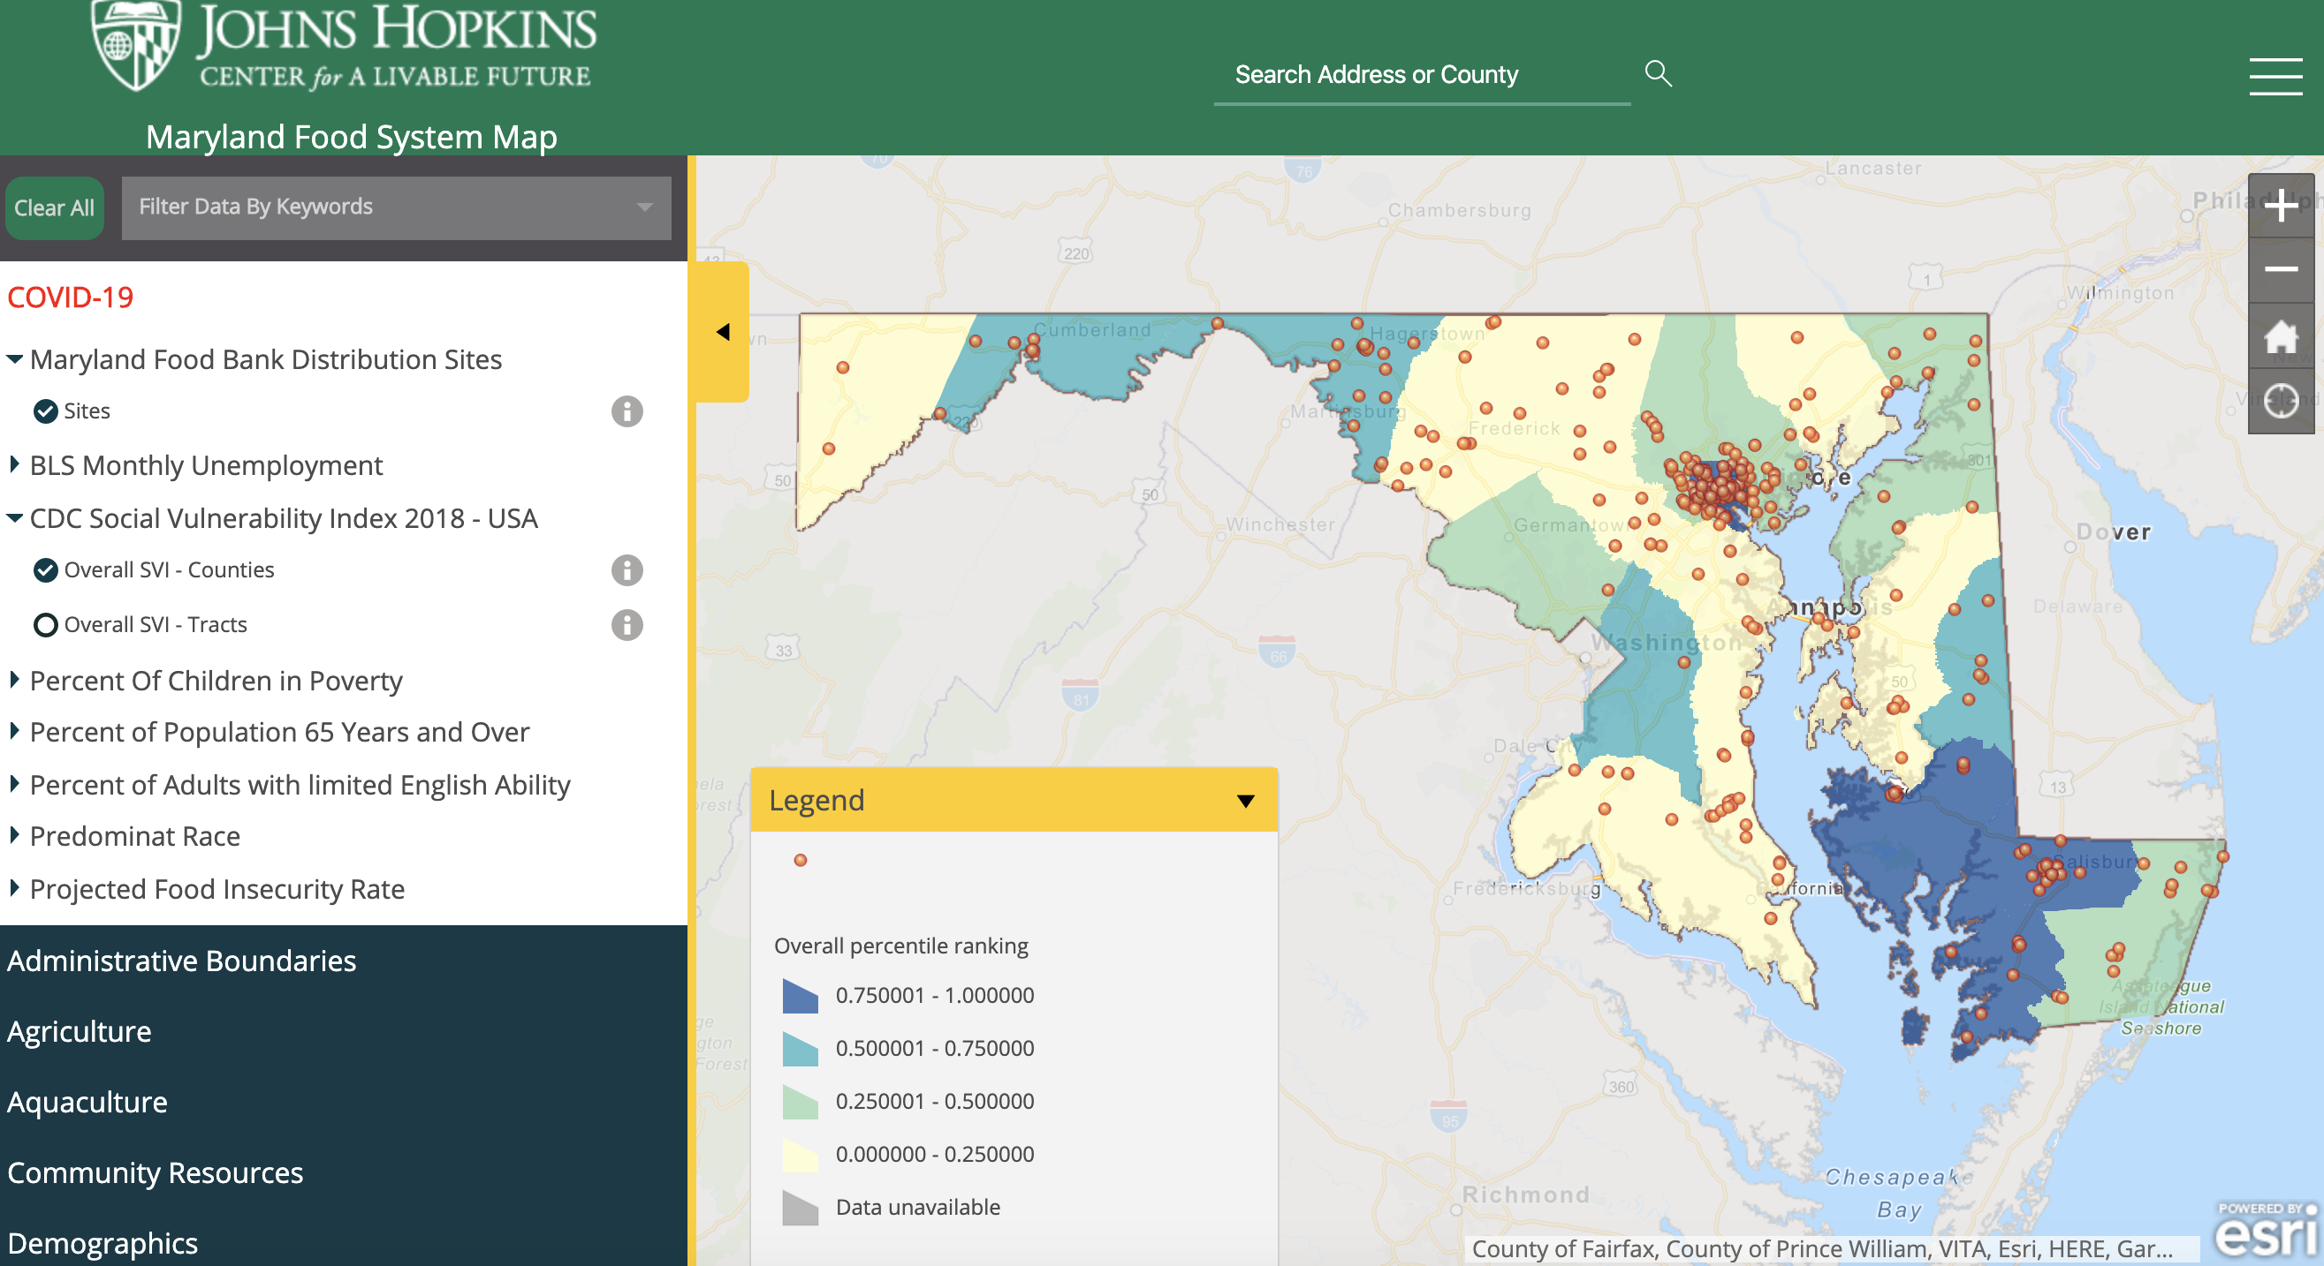
MARYLAND FOOD SYSTEM MAP
Maryland Food System Map

Slide 4
THANK YOU
CAITLIN MISIASZEK
JOHNS HOPKINS CENTER FOR A LIVABLE FUTURE
WWW.MDFOODSYSTEMMAP.ORG
CFISHE29@JHU.EDU

