Slide 1
COVID-19 in Baltimore City
July 20, 2020 | Joshua Sharfstein, MD

Slide 2
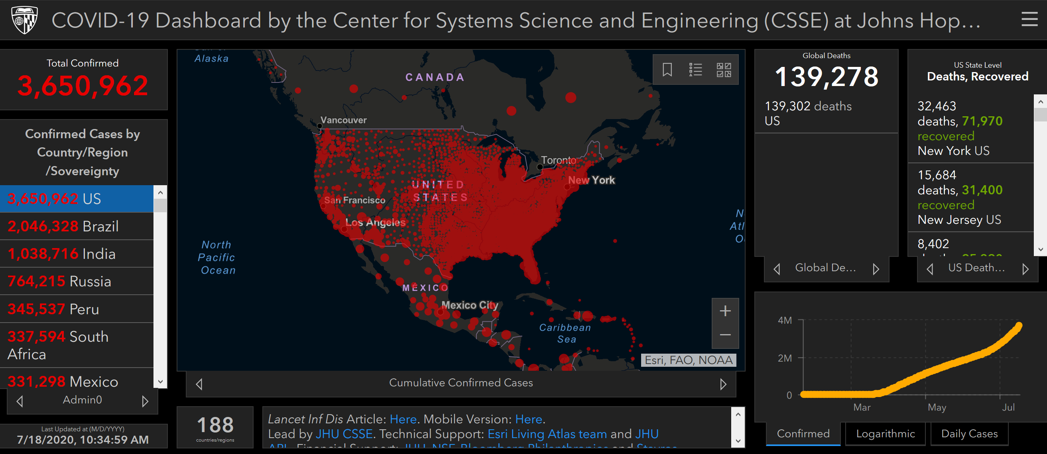
HTTP://CORONAVIRUS.JHU.EDU
2

Slide 3
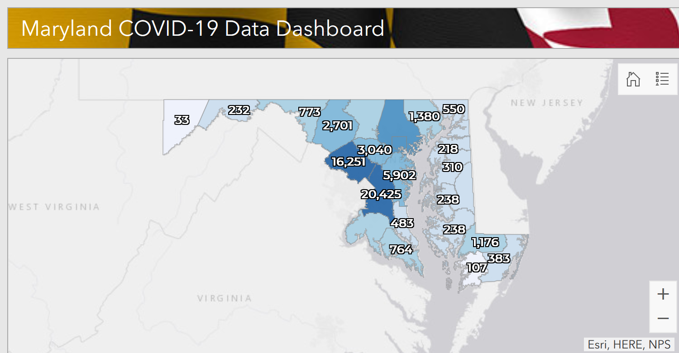
HTTP://CORONAVIRUS.MARYLAND.GOV
3

Slide 4
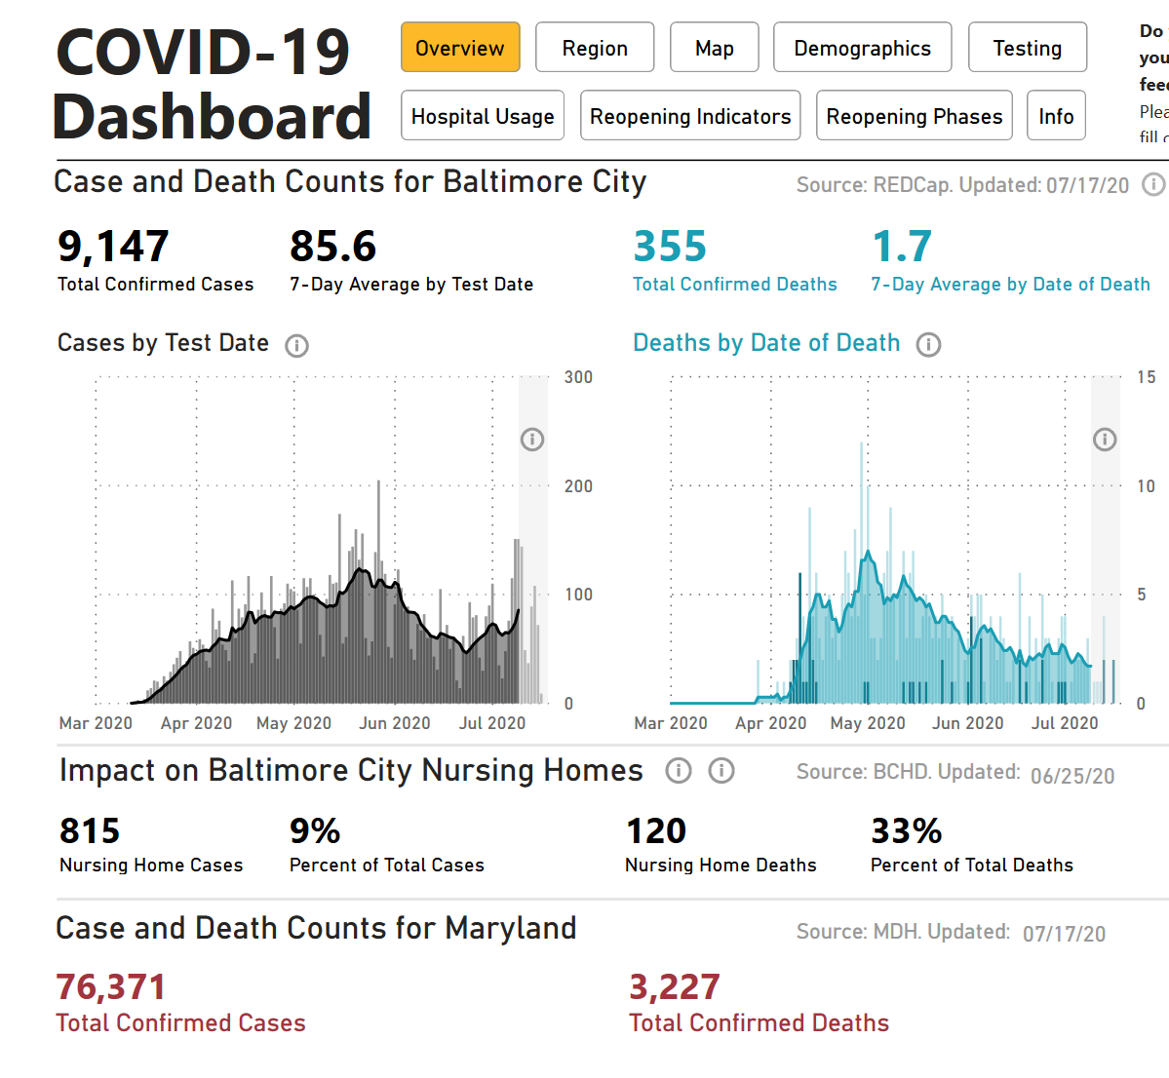
HTTP://CORONAVIRUS.BALTIMORECITY.GOV
4

Slide 5
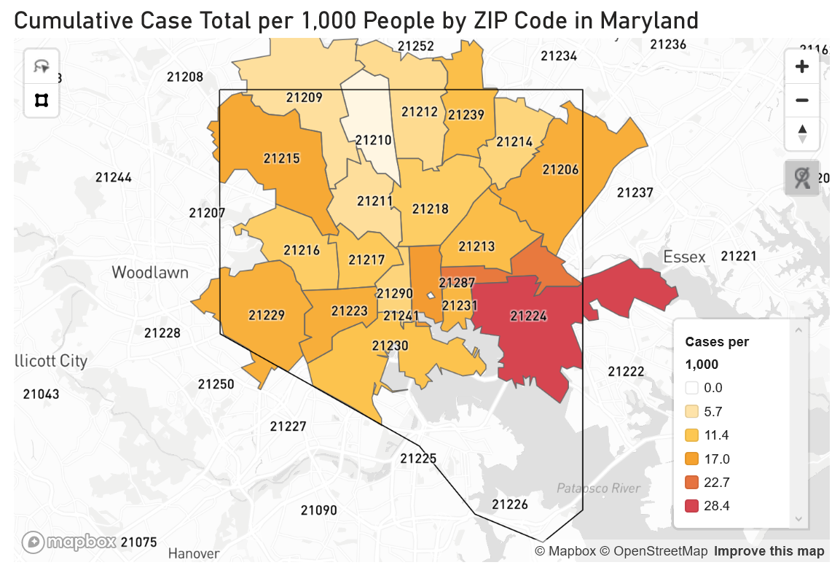
HTTP://CORONAVIRUS.BALTIMORECITY.GOV
5

Slide 6
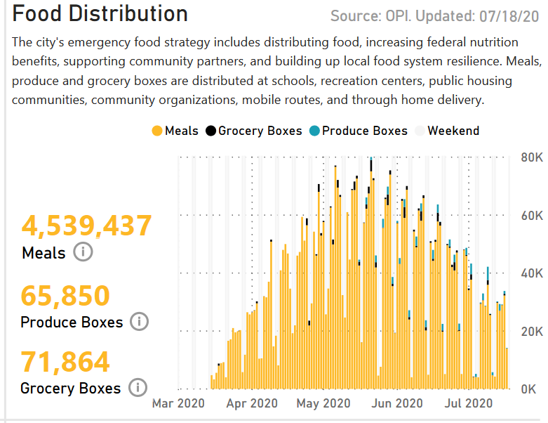
Challenge:
Food
Insecurity
HTTP://CORONAVIRUS.BALTIMORECITY.GOV
6
© 2020 Johns Hopkins University. All rights reserved

Slide 7
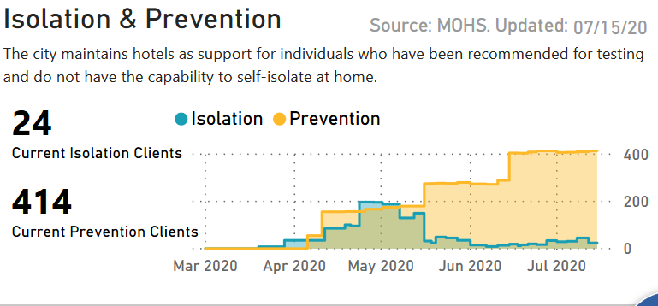
Challenge:
Housing
HTTP://CORONAVIRUS.BALTIMORECITY.GOV
7
© 2020 Johns Hopkins University. All rights reserved

Slide 8
Challenge:
Job Loss
8
© 2020 Johns Hopkins University. All rights reserved

Slide 9
Challenge:
Behavior Change
HTTP://CORONAVIRUS.BALTIMORECITY.GOV
9
© 2020 Johns Hopkins University. All rights reserved

Slide 10
Baltimore has unquestionably saved lives through public sector leadership, a public-private partnership to fight COVID-19, and the actions of many city residents.
Enormous challenges are still ahead.
Key challenges for Baltimore as cases rise:
Mobilize contact tracing system quickly and effectively
Reopen schools as safely as possible
Meet social and economic needs of city residents
Establish critical services and supports in the Latino community, where cases are concentrated and risk is high
Challenge:
New Waves
HTTP://CORONAVIRUS.BALTIMORECITY.GOV
10
© 2020 Johns Hopkins University. All rights reserved

