Slide 1
Data Exploration For DATA WORKS MD
By Amivi Atsu
University of Baltimore
BNIA-JFI Intern and Data Science Corps Student

Slide 2
What is Data Works MD & What Is My Role?
Data Works MD is an organization of professionals, students, and enthusiasts living and working in the Maryland area who are interested in topics related to data science.
DWMD organize monthly events, publish a newsletter, and work with local organizations to engage the data science community.
My role in this project is to collect various data, create a documentation about the process I followed to collect that data, analyze, and organize the data in a way that will be helpful in increasing the value that DWMD brings to the community.

Slide 3
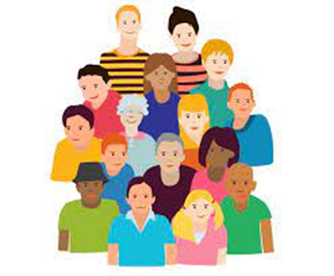
The Questions that This Project Needs to Address
Which cities are the members from?
When did the members join?
Did the membership signups increase during the COVID-19 lockdown?
What other Meetup groups are the members part of?
How often has a member attended an event?
What topics or activities are the members interested in?
What is the correlation between all those data?
What needs and wants of the members transpire from those data?
What is the demographic, careers, and ambitions of the members?

Slide 4
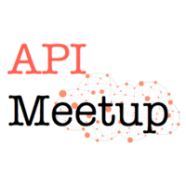
Data Science Tools That I Will Use For This Project
Allows for users to extract important data from the meetup groug(s).
Coding language and documentation software. – Will be used to access the API.
A text format that gives us a human-readable collection of data that we can access in a really logical manner.

Slide 5
Meetup API
Accessing the Meetup API of an organization is a protocol that requires the following handles:
Public facing client id that can get you to authorization API page.
Registered redirect URI will be used to validate future oauth2 requests.
Hidden client secret (AKA consumer secret).
Once we have the handles and passcodes, The following steps must be followed to retrieve data from the meetup API:
Granting Authorization
Getting the Access Code
Making and Saving Queries

Slide 6
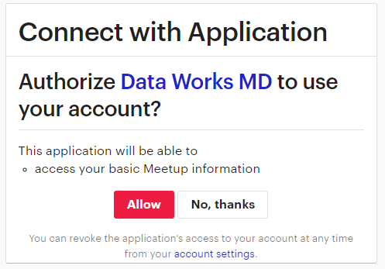
Meetup API Requesting Authorization & Access Token
https://secure.meetup.com/oauth2/authorize?client_dataworksmd.org/
Perform POST Request
‘code’: [ Enter code from step 3]
1)
4)
2)
Run the Json cell – Which will generate the final secret code.
5)
6)
With that final secret code, we could make any queries.
3)

Slide 7
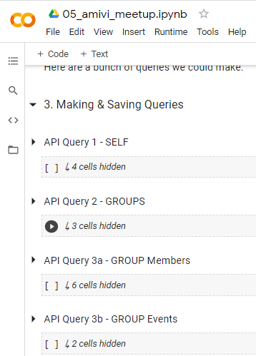
Meetup API Making and Saving Queries in API

Slide 8
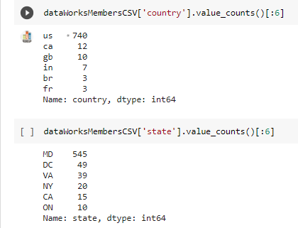
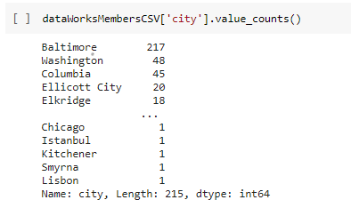
Data Exploration 1 - Where Are The DWMD Members From?
DWMD has a total of 2313 members as of 7/21/21

Slide 9
DATA WORKS MD – MEMBERS IN NORTH AMERICA

Slide 10
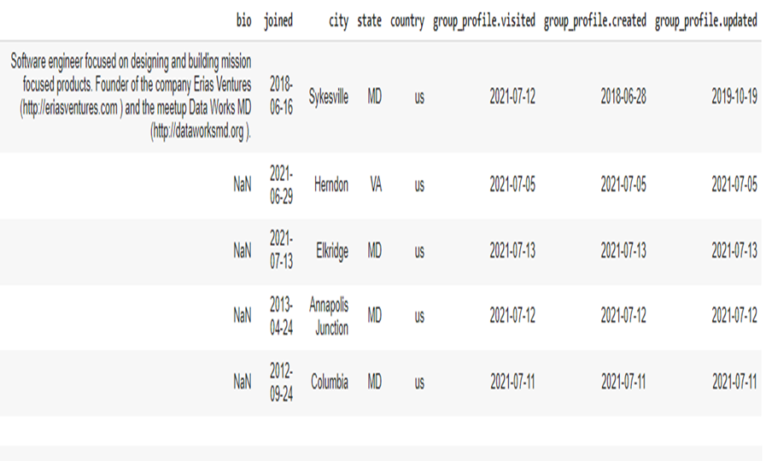
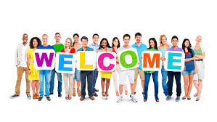
Data Exploration 2 – What Is The Joining Date Of The Members?

Slide 11
Additional Members Throughout The Years
*This graph is based on a list of 800 members.
* DWMD meetup was created on 06/28/2018.

Slide 12
What I plan To Do Next?
Do more queries to collect as many data as possible that could be beneficial to DWMD and the data science community.
Correlation among various datasets
Deeper analysis of the data collected
Use tools such as GIS and GIThub for additional visualization and code sharing

Slide 13
How Does Data Science Benefit Me?
An accounting major acquiring IT skills: Coding, programming!!
An entrepreneurship minor acquiring marketing skills: API’s, GIS!!
Fast and efficient technology
Innovation tools
Problem solving skills

Slide 14
THANK YOU!!

