Slide 1
MDCEP
Maryland center on economic policy grant
By
Loveth Akinyemi

Slide 2
Introduction
Loveth Akinyemi
(BNIA Data Science Crop)
Host organization
MDCEP (Maryland Center on Economic Policy) a non-profit, non-partisan organization committed to ideas that work for everyone and a public climate where they can prevail.

Slide 3
Data Exploration
What grants are available to the public
What factors affect the way community member receive grants
Criterial to qualify for grants.
Who can get the grant

Slide 4
Purpose of Grant
To help eligible applicant come out of cost created by Covid-19 Pandemic
For cost related to emergency protective measures conducted as a result of the pandemic
To support families with bills such as mortgage, medical created by the Pandemic.
To help the economy

Slide 5
Data and Tools
Source Data
State funding for coronavirus Pandemic
Data Type
CSV
Tools
Air Table ( sort data)
ArcGIS (story map)

Slide 6
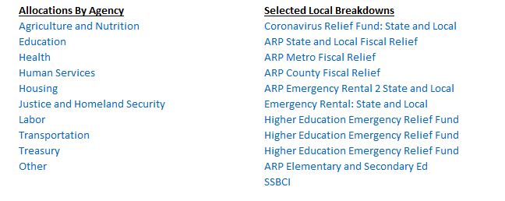

Slide 7
Baltimore City Grants
CRF payment to Baltimore City
$103,559
ARP Metro
$525,891,651
ARP City Allocation
$115,278,475
Emergency Rental Assistance in ARP
$14,036,632
Maryland Employment Based Allocation (sec 3003 (b))
$154,430
Very Small Business Portion (sec 3003(f))
$12,280

Slide 8
Allocation for Section 18004 (a)(1) of the CARES ACT (Higher Education Fund)
Baltimore City Community College $2,876,155
Minimum allocation for Grant to students and Maximum Allocation for institutional cost $1,438,077
University of Baltimore $9,315,657
Minimum allocation for Grant to students and Maximum Allocation for institutional cost $4,657,828
University of Maryland, Baltimore $2,077,903
Minimum allocation for Grant to students and Maximum Allocation for institutional cost $1,038,951
Loyola University $2,612,460
Minimum allocation for Grant to students and Maximum Allocation for institutional cost $1,306,230

Slide 9
Who make decisions about grant?
After the grant is made available, the state makes decision about the grant.
Steps required for Grant application process:
Search for grant
Determine if you’re qualified
Apply

Slide 10
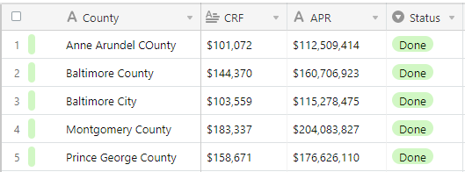
AIRTABLE

Slide 11
Current Findings; Baltimore city grant data Next Step; Story map

Slide 12
Q&A
Thanks for listening

