Slide 1
Using Qualitative Data to Make Your Numbers Speak
Data to Action Session
Notes:
Quantitative data can go far in delivering insight and making the case for change. Mixed methods approaches can increase the impact of that data with an experience-centered narrative, adding texture and nuance, and answering questions raised in the quantitative data. In this session, Emily Dowdall will discuss how to build out simple and effective qualitative research tools, such as surveys and structured interviews, to give voice to your numbers. Robert Cox will discuss how lenders and developers consider quantitative and qualitative factors in The session will explore examples of mixed methods research that have informed housing programs and policy.

Slide 2
Emily Dowdall
President, Policy Solutions
Robert Cox
Managing Director, Community Lending
Notes:
Headshots are available on the network drive: P:\Photos and Images\Board & Staff

Slide 3




Reinvestment Fund
Reinvestment Fund is a national mission-driven financial institution that creates opportunity for underserved people and places through partnerships. We marshal the capital, analytics, and expertise necessary to build strong, healthy, and more equitable communities.
$3.2B
Cumulative investments and loans since 1985
830+
investors: individuals,
foundations, financial &
civic institutions, government

Slide 4








How We Work
ORGANIZED
PEOPLE
ORGANIZED
MONEY
ORGANIZED
CAPACITY
ORGANIZED
DATA

Slide 5
Agenda
Qualitative Tools Overview
Qualitative Tools in Action
  Evaluating Emergency Rental Assistance
  Qualitative Underwriting at Reinvestment Fund
Discussion
  Current quant research that would benefit from qual inputs?
  What is the right tool for you?
Notes:
How many of you already have experience with qual or mixed methods work? Are there other uses you would add to this list?

Slide 6
Overview

Slide 7
How We Use Qualitative Tools
Explore behaviors, experiences, and motivations that drive quantitative trends
Improve interpretation accuracy
Capture complexity and nuance behind the numbers
ID unintended outcomes, explain unexpected outcomes
ID factors that increase or impede policy/ program
Tell a compelling story
Notes:
How many of you already have experience with qual or mixed methods work? Are there other uses you would add to this list?

Slide 8



Qualitative Tools
Interviews
Focus Groups
Surveys
In-depth understanding of individual perspectives
Exploratory research and comparisons across / within identity groups
Larger samples with quantitative features

Slide 9
Interviews
Structured Interviews
Semi-Structured Interviews
Unstructured Interviews
Follow a set script for consistency and comparability across interviews.
More flexible; a set of core questions supplemented by spontaneous probes.
Conversational, no set question list.
Useful in exploratory research, where specific lines of inquiry are still in development.
Time-intensive to conduct and analyze
Need for advanced interview skills inverse to degree of structure

Slide 10
Focus Groups
Gather diverse perspectives on a specific topic.
Illuminate complex behaviors and attitudes through participant interaction
Illustrate similarities and differences within and between groups (e.g., attitudes about proposed zoning changes expressed in a group of homeowners vs. a group of renters)
Gather data points more quickly than interviews
Requires active facilitation. Risk of group think, self-censorship

Slide 11
Surveys
Potential to collect much larger sample, ability to quantify
Facilitate cross-sectional and/or longitudinal analysis
Online survey tools are affordable and easy to use, but may not reach desired target population (respondents tend to skew higher-income, highly educated)
Requires careful question design; piloting is ideal to test for clarity, bias, and length of time to complete.
Consider import/feasibility of random vs. purposive sampling

Slide 12
Evaluating Emergency Rental Assistance

Slide 13
Understanding Tenant Experiences of the Emergency Rental Assistance (ERA) Program
Report from National Low Income Housing Coalition, Housing Initiative at Penn, and Reinvestment Fund
Context: the federal government created the ERA Program to help low-income renters address back rent and utilities during the pandemic. Site-level admins had significant control over local program structure.
Goals:
Learn the characteristics of households who applied for ERA
Shed light on the experiences of tenants who applied for ERA, and their likelihood of receiving money
Measure the impact of ERA on short-term tenant outcomes (housing stability, financial wellbeing, physical and mental health, child-related outcomes.)

Slide 14
Understanding Tenant Experiences of the Emergency Rental Assistance Program
Study Components
5 Primary Sites
5 Additional Sites
Allegheny County, PA • Denver County, CO • Louisville/Jefferson County, KY • Northern Ponca Housing Authority • State of Oregon
Baltimore County, MD • Charlotte-Mecklenburg County, NC • State of Connecticut • Come Dream Come Build (Cameron County, TX) • Byrd Barr Place (King County, WA)
Analysis of administrative data
Tenant surveys only
Tenant surveys
Landlord and tenant focus groups
Program admin interviews

Slide 15
Surveys
 | Survey Participants | Participants with Funding
Primary Sites
Allegheny County, Pennsylvania | 1,972 | 81.4%
Denver County, Colorado | 351 | 90.0%
Louisville/Jefferson County, Kentucky | 881 | 63.2%
Northern Ponca Housing Authority | 69 | 94.2%
State of Oregon | 3,210 | 85.3%
Survey-Only Sites
Baltimore County, Maryland | 1,215 | 61.0%
Charlotte-Mecklenburg County, North Carolina | 236 | 69.9%
State of Connecticut | 2,887 | 74.7%
Come Dream, Come Build, Cameron County, Texas | 63 | 87.3%
Byrd Barr Place, King County, Washington | 34 | 94.1%
Total | 10,918 | 77.2%
Online survey through the secure survey platform Qualtrics in eight languages: English, Spanish, Chinese, Arabic, Nepali, Russian, Vietnamese, and Somali.
Distributed survey through site admins to all households that had applied for assistance, regardless of funding status.
All who completed survey were entered in a lottery, 25 entrants won a $100 Visa debit card
The survey tool, consent language, and compensation language approved by Penn IRB
t-tests and chi-square tests - whether experiences significantly differed funding status
Regression analyses on housing status, health and well-being controlling for level of anxiety when applying, the site, language, ethnicity, race, age, and presence of children.
Notes:
Logit regression analyses to test the impact of funding on housing status, health and well-being, with controlling for whether a respondent was housed in a rental unit (e.g., living in a house, apartment, or condominium that the respondent was renting) when applying for ERA and their level of anxiety about staying in housing when applying, as well as the site, language, ethnicity, race, age, and presence of children in the household.

Slide 16
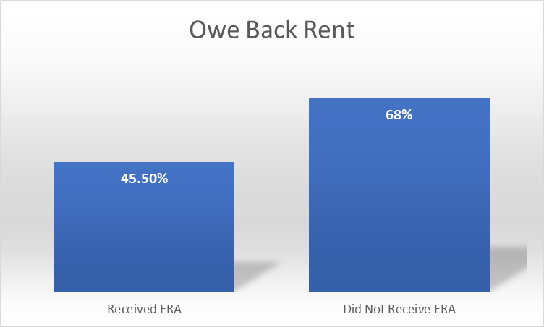
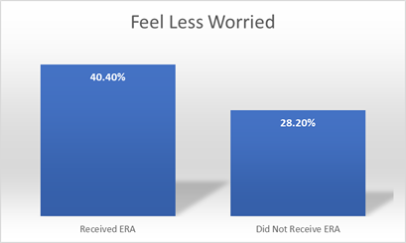
Survey Results
Survey analysis suggests that those who received ERA funding experienced more positive outcomes than those who did not receive funding when measured by metrics like housing security, financial well-being, outcomes for children, healthcare access, and general health.

Slide 17
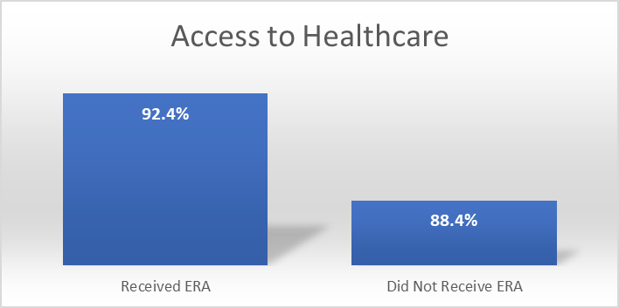
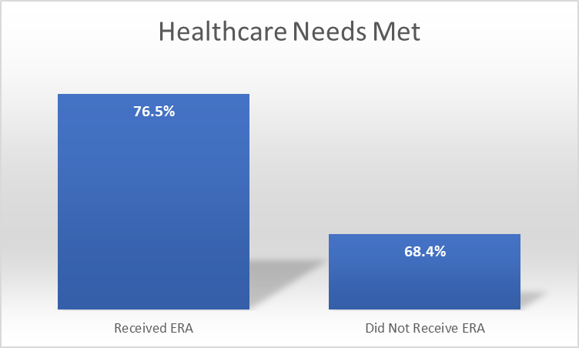
Survey Results

Slide 18
Focus Groups
HIP recruited survey participants (tenants) from different ZIP codes and funding statuses
Sent email invitation through Qualtrics
Successful and unsuccessful applicants
Diverse in race, ethnicity, age, gender, and use of subsidy
RF recruited owners through local program admins and trusted intermediaries
Landlords were diverse in portfolio size and tenant subsidy use
All tenant and landlord focus group participants were compensated with a $50 gift card
Focus Group Participants by Location
 | Tenants | Landlords
Allegheny County, PA | 9 | 6
Denver County, CO | 8 | 6
Louisville/Jefferson County, KY | 5 | 4
Northern Ponca Housing Authority | 7 | 7
State of Oregon | 10 | 11
Total | 39 | 34
Notes:
10 focus groups, two for each of the primary sites, with one focus group comprising tenants and the other landlords. In total, 39 tenants and 34 landlords participated in the focus groups (Table 3). The tenant focus groups included individuals who both did and did not receive assistance, though all individuals had applied for assistance. The landlord focus groups likewise included both landlords whose tenants had applied for assistance successfully and those whose tenants had applied for assistance without success. Each focus group lasted 60 to 90 minutes.

Slide 19
Focus Group Results
ERA provided rent relief, peace of mind, and ability to meet other household needs.
Some participants still faced housing precarity again after assistance ended.
Those who didn’t receive ERA believed it could have stabilized their finances, improved relations with their landlord, and allowed them to avoid a move or eviction
Most landlords said ERA provided critical support at a time when they were struggling to collect rents and meet their own financial obligations
Landlords observed that ERA helped tenants who were truly in need and prevented evictions and turn-over, but many also said some tenants gamed the system
Landlords stated that simplified processes, transparency about application status, and responsive administrators would have addressed many of their concerns.
Most landlords said they would participate in a future version of the program

Slide 20
Focus Group Results
“It gave us a leg up and came at a time when it was direly needed. It was like a life raft.”
“I felt relief, no more nausea and felt physically different.”
“I would see the effects COVID had with people losing their jobs, people contacting COVID, being off work for so long, schools being out. I saw those people be able to take advantage of the program, and it really helped them get back on their feet…I did see it work well with a lot of our tenants.”
Rollout was “messy” and “a bit chaotic.” “[t]he frontline staff who are taking these applications need to be better trained.”
“If you have more than one unit, you shouldn’t have to input your info every time. Money should first be put into the software and making it robust. It would’ve been a more efficient process.”
One participant was able to meet special medical needs and improve indoor air quality to the point …
“where we wouldn’t have to be going to the doctor’s appointment so often.”

Slide 21
Interviews
Hour-long interviews with 13 administrators from five primary sites.
Interviews focused on program operations and how and why programs changed over time.
NLIHC asked non-tribal program administrators about administrative structure; goals, priorities, and intended tenant impacts; and strategies used to achieve these goals.
Tribal ERA programs faced unique housing challenges, so NLIHC used a modified questionnaire to determine how these circumstances may have altered decisions.
Several participating programs were complex with multiple program arms, each with their own unique processes.
For these programs (Louisville, Denver, OR), we conducted supplemental interviews with staff at partner agencies and organizations
All interviews were recorded and transcribed using Otter.ai.

Slide 22
Interview Results
Admins constantly balanced the requirements of speed, changing regulations, and maintaining a high level of program integrity.
Admins addresses household stabilization, eviction prevention, and other key housing challenges: e.g., Louisville and Denver emphasized eviction prevention, Tribal administrators were particularly focused on relieving overcrowding.
Adminiss had never implemented a program in such a short amount of time or under such extreme pressure: “it has been fairly reactive…Oh, there’s this new bill, now we have to focus on application processing speed.”
2021 surge in potentially fraudulent applications led admins to increase number of staff dedicated to compliance, conducted additional training with partner organizations, and added additional steps in the internal review process – slowing processing speed.

Slide 23
Interview Results
Most programs used a third-party, “off-the-shelf” software system to process applications Admins found that these programs were often inflexible and could not be customized to match how the program processed applications.
All primary sites utilized formal and informal partnerships with nonprofits and for-profit companies to operate their programs, though the structure of partnerships varied.
e.g., Allegheny County contracted with multiple nonprofits to implement its ERA program, but the County’s contracting process was so cumbersome and slow that the County shifted to contracting directly with one nonprofit, and that nonprofit in turn contracted with a network of smaller nonprofits.

Slide 24





Program Recommendations Based on Mixed Methods Work
Invest in program infrastructure (staffing, training, technology) for effective and timely communication with tenants and landlords throughout the application process and reduce time between application and receipt of funds.
Create mechanisms to link and match data across government systems and databases to support ERA outreach, reduce application length by pre-populating fields, and allow for categorical eligibility for participants in a different income-limited-program
Reduce burdensome documentation requirements, provide clear instructions to applicants about the application requirements and process, and create alternatives to online applications
Allocate resources to application support and housing navigation throughout the process
Use direct-to-tenant assistance to ensure access for tenants whose landlords are hard to reach or unwilling to participate

Slide 25
Qualitative Underwriting at Reinvestment Fund

Slide 26
Framing the Question
Conventional CRE / Bank
CDFI / Reinvestment Fund
Driven almost entirely by hard numbers
Starts from the same financial discipline, then layers in judgment.
DSCR
LTV
JUDGMENT ABOUT
Mission
Community
Capacity
Net Worth
Appraised Value
CDFI underwriting keeps the full quantitative discipline of a bank and adds a structured read on mission, community, and organizational capacity.
Community impact and organizational mission are not traditionally valued.
At Reinvestment Fund, qualitative factors are structurally embedded in the lending practice, not added on.

Slide 27
Mission Fit as a Threshold Requirement
Credit Policy: Mission fit is a prerequisite for pursuing any loan opportunity, not a bonus feature
Every deal starts by asking whether it belongs at RF at all, before the numbers are run
Loans array across a spectrum of mission attributes — alignment shapes terms even after the mission fit bar is cleared

Slide 28
Qualitative Dimensions of Underwriting
Qualitative categories carry equal weight with quantitative ones • staff exercise discretion when signals diverge
1
Community Impact & Connection
2
Organizational Strength & Management Depth
Sector impact
Board depth
How the project moves an underserved sector or place
Governance capacity and engagement
Stakeholder relationships
Staff tenure
Depth of ties to partners, funders, and anchors
Continuity and experience of the team
Community support
Track record
Evidence the community stands behind the project
Demonstrated delivery on prior work

Slide 29
Where Qualitative Judgment Changes the Deal Terms
Equity
Loan-to-Value
Guarantees
DEFAULT
DEFAULT
DEFAULT
20% standard
Policy thresholds
Guaranty strength
EXCEPTION
EXCEPTION
EXCEPTION
Deviation permitted for underserved borrowers and strong mission alignment
Exceptions above policy ceilings permitted for high-mission projects
Absence of a full guaranty can be approved case-by-case, with rationale
Each exception weighs mission benefit against diluted credit protection.

Slide 30
The Impact Framework: Capturing Qualitative Diligence
The Pre-Flight Tool a structured qualitative data-collection instrument
1
2
3
4
Mission Fit
Site Visits
Sponsor Track Record
Community Support
Why this deal belongs at RF
In-person meetings with organizational leadership
Experience with similar communities and projects
Documented evidence the community backs the project
Narrative fields sit alongside the financial ones and are reviewed before a deal proceeds.

Slide 31
Baltimore Case Studies: Qualitative Underwriting in Practice

Slide 32
Case Study: NAM Predevelopment Loan
$850,000 predevelopment loan to prepare a large, underutilized historic market for larger redevelopment
Business as operating had only limited liquidity and projected operating deficit
Repayment depends on closing on +$25M in new capital, including debt and scarce NMTC allocation

Slide 33
Predevelopment Loan: The Qualitative Case
Importance of physical asset to the neighborhood; importance of project to the community – project as “market maker”
Sponsor track record over balance sheet: lead developer is a “model borrower” on a prior RF loan
Institutional relationship as credit support: a 20-year nonprofit partner
Philanthropic guaranty pool

Slide 34
Case Study: Afro Charities Bridge Loan
Up to $3.6M to rehabilitate the historic Upton Mansion as home for AFRO News’ 130-year Black history archive
Borrower had almost no operating history; first full-time Executive Director hired only in 2022
Repayment relies entirely on capital campaign proceeds, with no expected coverage from operations
20% of the bridge loan is backed only by uncommitted, prospective fundraising

Slide 35
Afro Charities: The Qualitative Case
Importance of the project:
  Literally an investment in community voice
  Important physical asset; stabilizing, catalytic investment
Leadership narrative:
  Executive Director’s generational tie to the newspaper, plus $8.9M raised to date
  Organizational trajectory credited explicitly — growth since a 2022 feasibility study treated as real progress

Slide 36
Case Study: Wide Angle Youth Media — Service Center
Up to $3.65M bridging a capital campaign for a purpose-built youth media arts facility
Primary collateral is capital campaign pledges
$1,020,000 (1/3 of loan) rests on uncommitted, prospective fundraising

Slide 37
Wide Angle Youth Media: The Qualitative Case
Project impact: Youth development/Community voice
Leadership tenure: Executive Director with 20+ years at the organization and strong reputation in industry
Demonstrated fundraising trajectory: 78% of goal raised pre-closing, plus two prior campaigns executed
Unsolicited validation: important national grant read as confirmation of organizational health

Slide 38
Qualitative Collateral
Not one lever, but a set of factors RF chooses among by situation
Impact
Commitment to place
Importance of the service and of the physical asset
A durable stake in the community and location
Qualitative
Collateral
Community support
Experience & mission
Documented backing from the people served
Mission commitment and a history of success

Slide 39
Discussion

Slide 40
Discussion
Current quant research that would benefit from qual inputs?
What is the right tool or mix of tools for you?
Notes:
How many of you already have experience with qual or mixed methods work? Are there other uses you would add to this list?

Slide 41
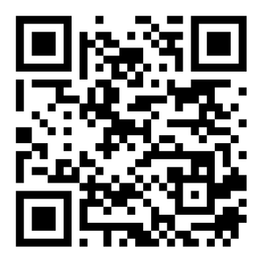
See where 25 years of investment in Baltimore has taken us.
baltimore.reinvestment.com

