Slide 1
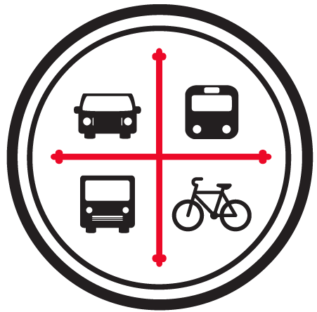
Transportation Data and Advocacy
July 17, 2026
BNIA Data Day - From Data to Action Session

Slide 2
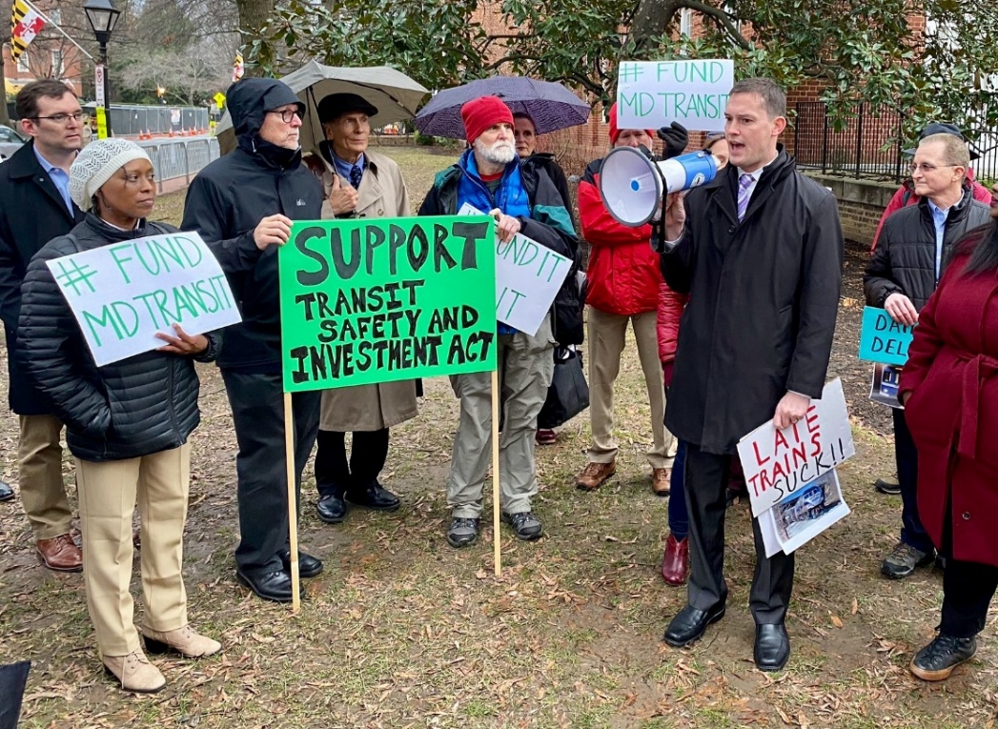
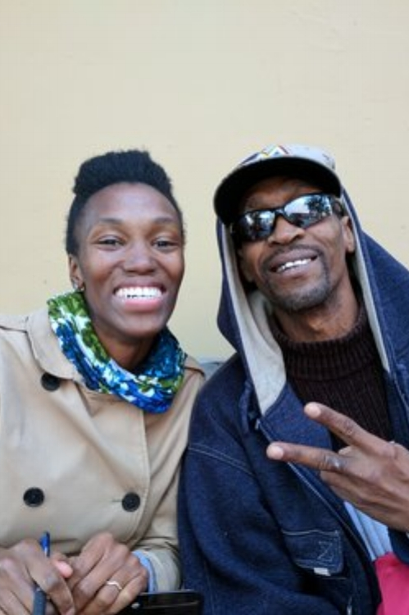
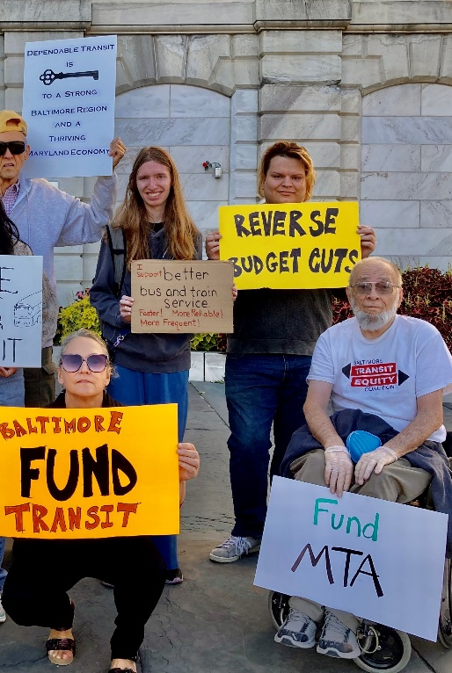
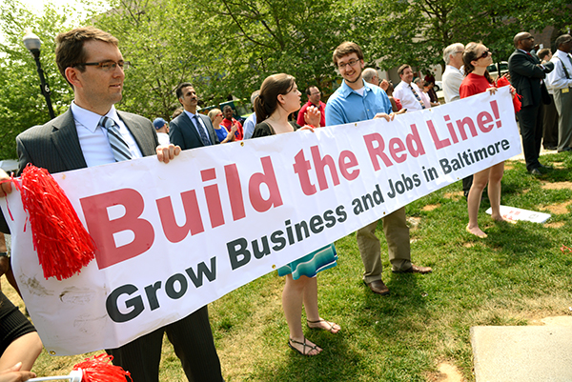
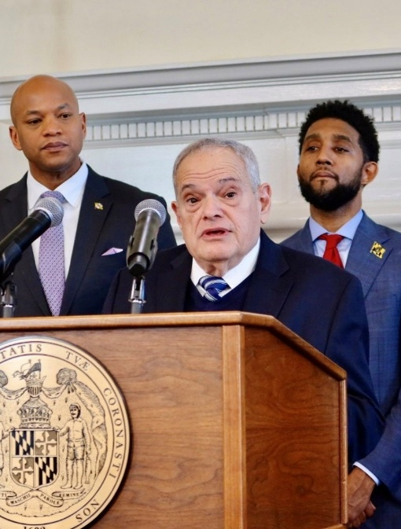
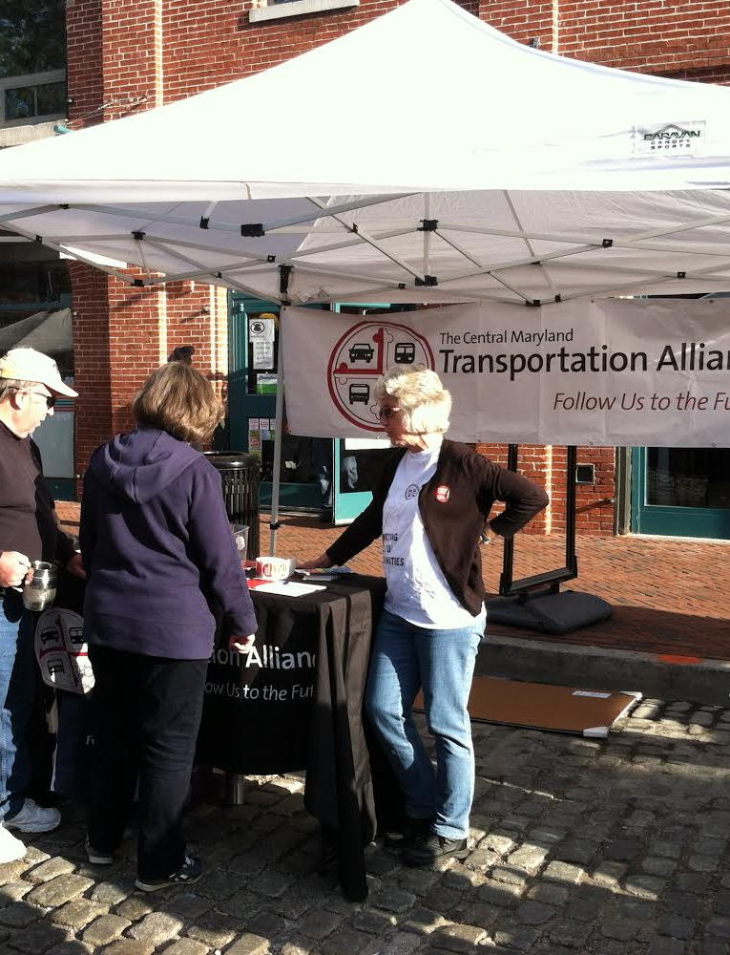
Notes:
First, we want to introduce ourselves a little bit. We’re the Central Maryland Transportation Alliance, based a block away on Mount Royal Avenue where we work as an initiative of the Baltimore Community Foundation.
Go though photos to give examples of some of the work we do.

Slide 3
Chair
Laura Gamble
Regional President Greater Maryland
PNC Bank
Vice Chair
Dr. Celeste Chavis
Associate Professor
Morgan State University
Vice Chair
Ryan O’Doherty
Vice President
Mercy Medical Center
William Baker
Executive Director
Clayton Baker Trust
Cheri Cernak
President
CRC Restaurants
Liz Cornish
Enhanced Services Director
South Baltimore Gateway Partnership
Scott Gilson
Vice President
M&T Bank
Crystal Harden-Lindsey
Vice President for Community Impact
Baltimore Community Foundation
Ronald J. Hartman
Managing Director
WSP USA, Inc.
Patrice Kingsley
Manager, CareFirst Engagement Centers
CareFirst
Jon Laria
Managing Partner
Ballard Spahr, LLP
Walter D. Pinkard, Jr
Senior Advisor
Cushman & Wakefield
Laurie Schwartz
President
Waterfront Partnership of Baltimore
Jane Shaab
Executive Director UM BioPark
University of Maryland, Baltimore
Greg Smith
Director of Transportation Services,
The Johns Hopkins University
Scot Spencer
Associate Director, Local Policy
The Annie E. Casey Foundation
Gina Stewart
Executive Director
BWI Business Partnership
Shelonda Stokes
President
Downtown Partnership of Baltimore
C. William “Bill” Struever
Managing Director
Cross Street Partners
Michele Whelley
Principal
M.L. Whelley Consulting, LLC
Notes:
We have an advisory board whose makeup should give you an idea of the stakeholders who care about this issue and support the work that we do. It’s a mix of businesses, philanthropy, and institutions. We don’t receive any government funding – our funding comes from philanthropy and grant makers, business contributions, and individual donations.

Slide 4
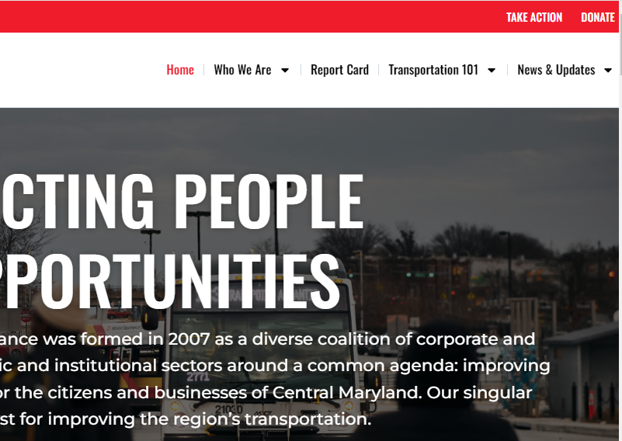
Notes:
If you want to get more of a sense of what we do, you can check out our website www.cmtalliance.org
And data plays a big role in our advocacy work. For example, at the top here you see the Report Card. Which would link you to our Transportation Report Card, a prime example of how we use data in our advocacy work.

Slide 5
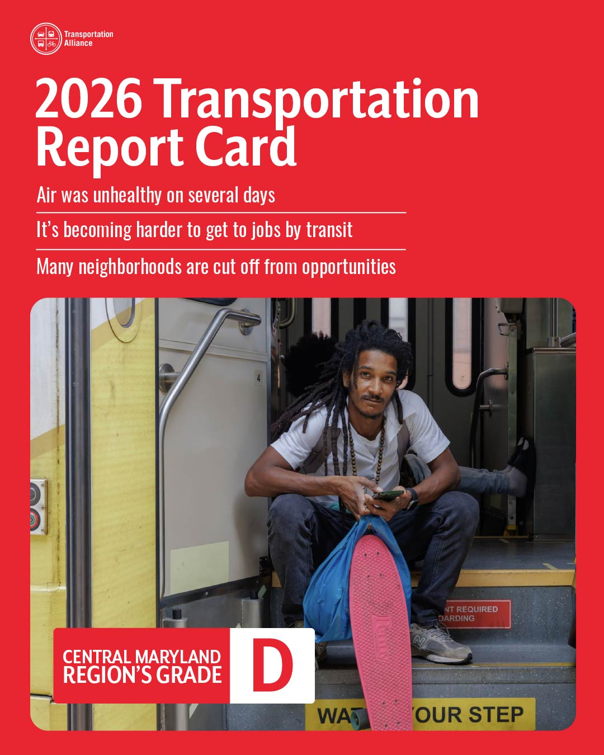
Affordability
Center for Neighborhood Technology, Housing and Affordability Index
Job Access By Car
University of Minnesota Accessibility Observatory
Job Access By Transit
University of Minnesota Accessibility Observatory
State of Good Repair
American Society of Civil Engineers
Commute Mode
U.S. Census Bureau, American Community Survey
Walkability
Redfin Walkscore
Physical Activity
Centers for Disease Control and Prevention
Air Pollution
U.S. Environmental Protection Agency
Commute Time
US Census Bureau, American Community Survey
Reliable Transit
ARIES for Transit
Safety
Smart Growth America’s “Dangerous By Design”
Disconnected Communities
Census Bureau, American Community Survey
Notes:
Here’s the cover to our most recent report card. We received a D, which is pretty much the same grade we’ve been getting since we started this report card in 2015. On the right here, you can see all the indicators we look at to compile our grade and the data sources.

Slide 6
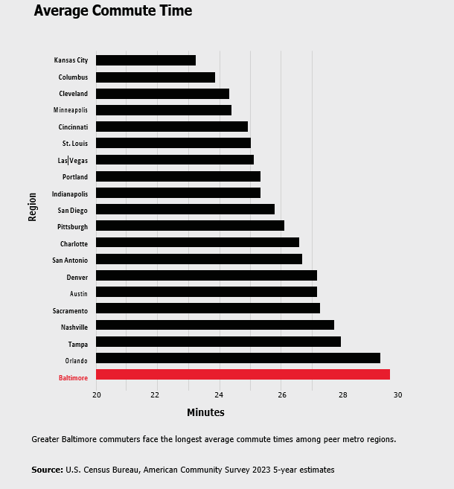
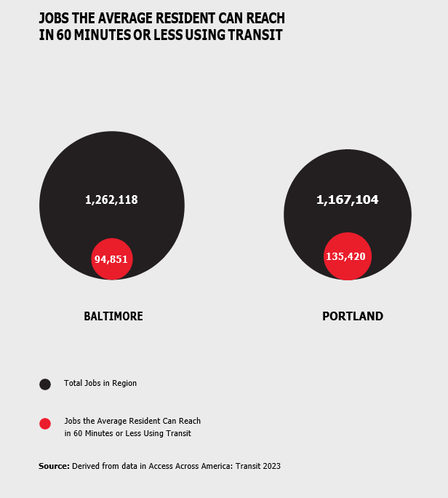
Notes:
Just to show a couple of examples of how we use data in the report card.
On the left is graph for our Commute Time indicator showing average commute time of Baltimore and our peer regions. You can see we have the longest average commute time.
And on the right, is our indicator for Job Access by Transit showing how many total jobs there are in the region (the large circle) and how many of those jobs on average are accessible in an hour or less using public transit.

Slide 7
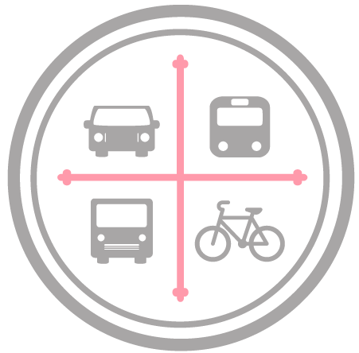
Transportation 101
Advocacy Workshops
Notes:
So that’s one way we use data, but our focus today is on our other program called Transportation 101

Slide 8
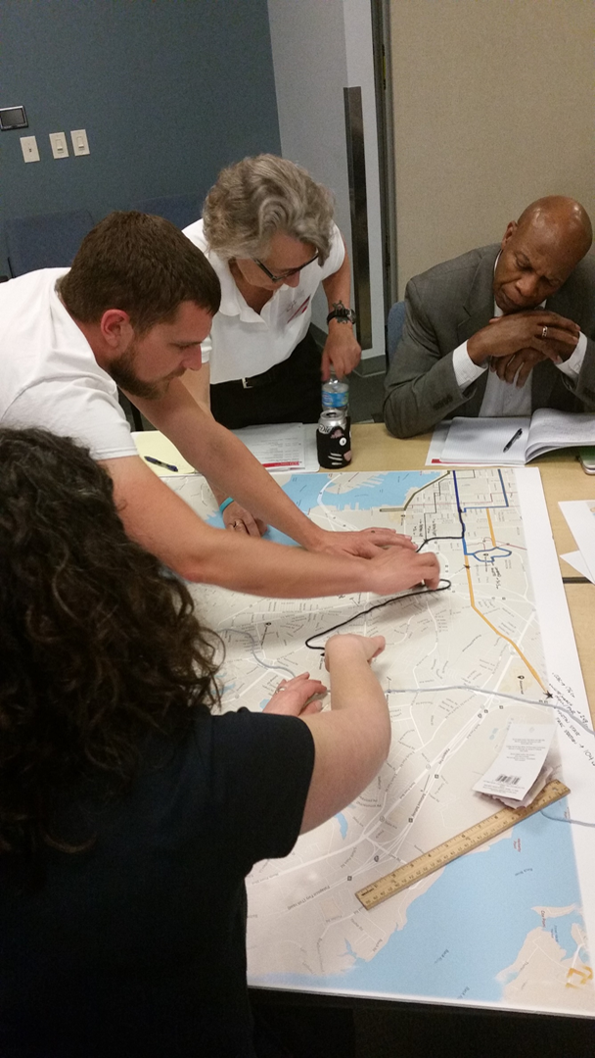
What is T101?
A free 7-week educational and advocacy workshop open to all residents and stakeholders of the region
Modeled on a long-running program in Denver called the Citizen’s Academy
During the course of the workshop, participants attend a weekly 3-hour class, learn from local experts and leaders, connect with other residents, and create individual action plans

Slide 9
Overview of sessions
Session 1 – Setting the Stage
Session 2 – Using Data and Alumni Updates
Session 3 – Walking the Walk with City DOT
Session 4 – MTA and Spheres of Influence
Session 5 – Envisioning the Future and Effective Advocacy
Session 6 –Advocacy Skills Practice
Session 7 – Taking Action and Keynote Address
Notes:
Here’s an example of how a typical seven week course might be set up. The curriculum changes and adapts over time, but

Slide 10
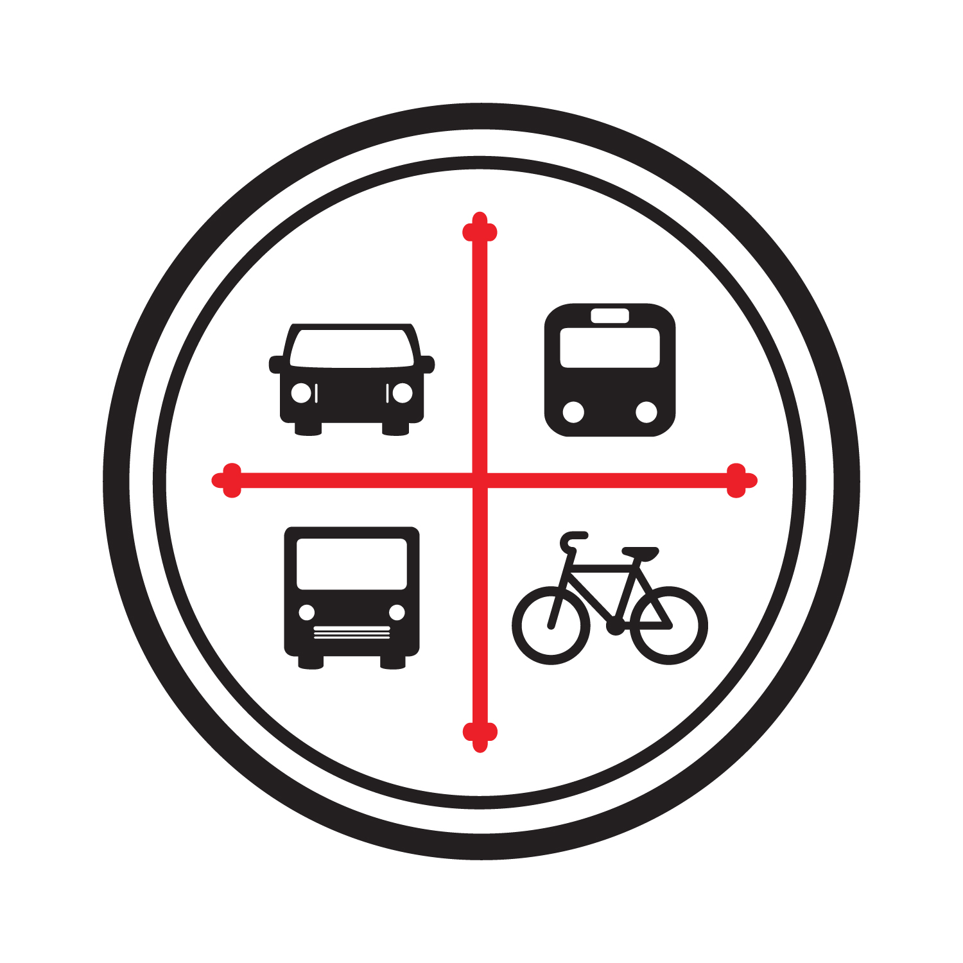
What will be the results?
Educate emerging leaders: Participants will attend class once a week for seven weeks to receive a deeper understanding of regional transportation issues
Broaden networks: Participants will engage with peers, experts and advocates, share their own T101 experience and create an alumni network
Empower advocates: Participants will go from concerned citizens to informed advocates and create their own individual action plans

Slide 11

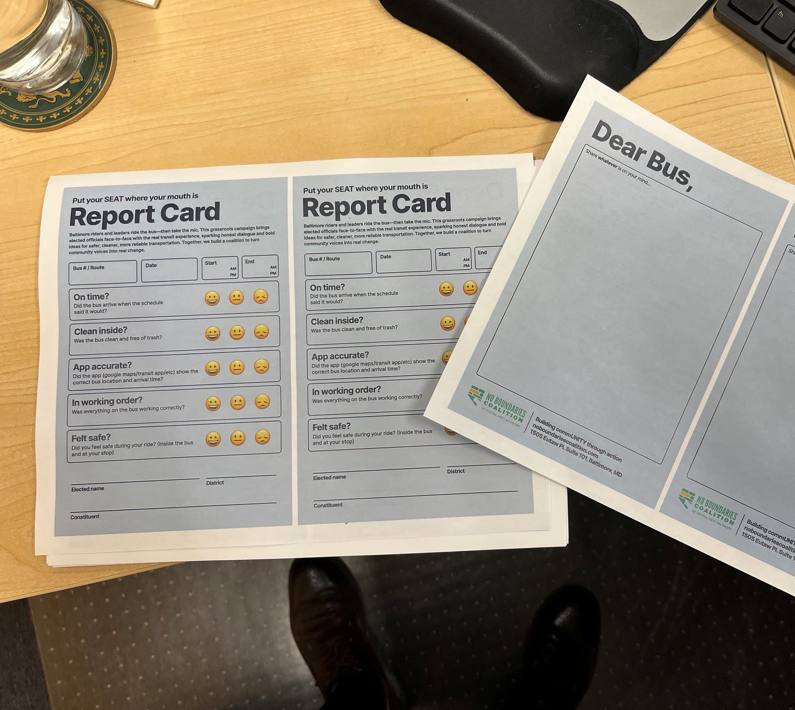
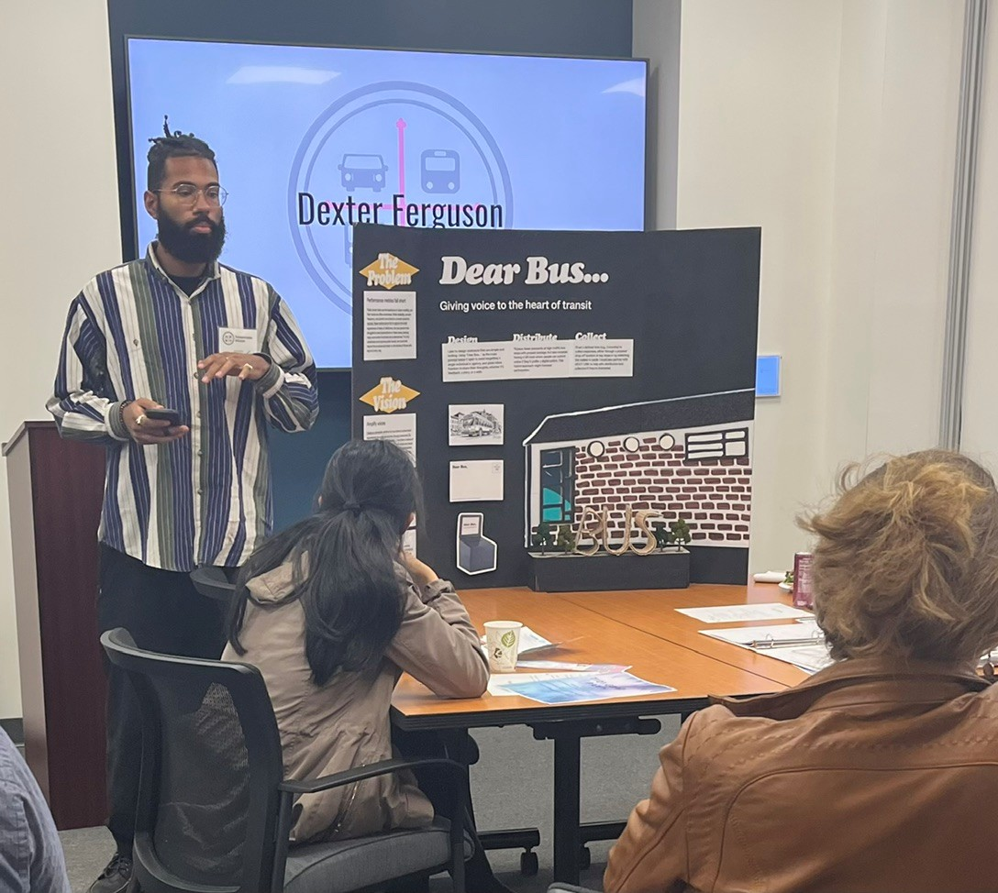
Data + Storytelling =
Individual Action Plans

Slide 12
Power Mapping
What power mapping involves
  Defining clear goals
  Building a visual map
  Assessing support and influence
  Researching connections
  Developing a strategy
Why power mapping is useful
  Builds relationships
  Reveals hidden connections
  Increases effectiveness

